Slide 1
Global First Power
NEA Workshop:
High Temperature Reactor and Industrial Heat Application

Slide 2
Global First Power – The MMR™ Technology
Global First Power Limited Partnership is a Joint Venture between Ontario Power Generation (OPG) and Ultra Safe Nuclear Corporation (USNC)
We aim to deploy a new form of safe, clean, reliable, and commercially-viable energy to Canada and other countries
Simple and Safe Reactor – USNC MMR™
Generation IV Technologies
HTGR - Micro Modular Reactor 5 MWe/ 15 MWth
Gas-cooled and uses FCM™ Fuel
No Refuelling required over lifetime
Modular Design provides for factory fabrication
FOAK project underway planned operation in 2026
MMR™ Reactor
High performance fuel – FCM®
Next generation improvement in TRISO fuel
Silicon Carbide based material innovation
Safe at much higher temperatures
Full containment of radioactivity
Silicon Carbide
TRISO
Particles
FCM™ Fuel

Slide 3
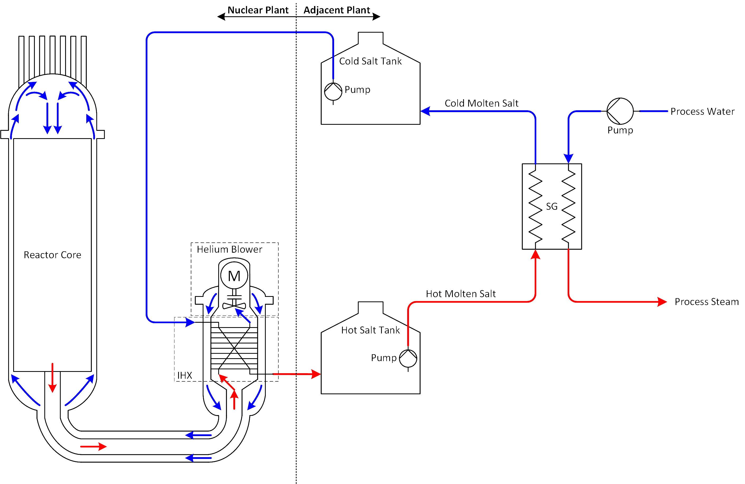
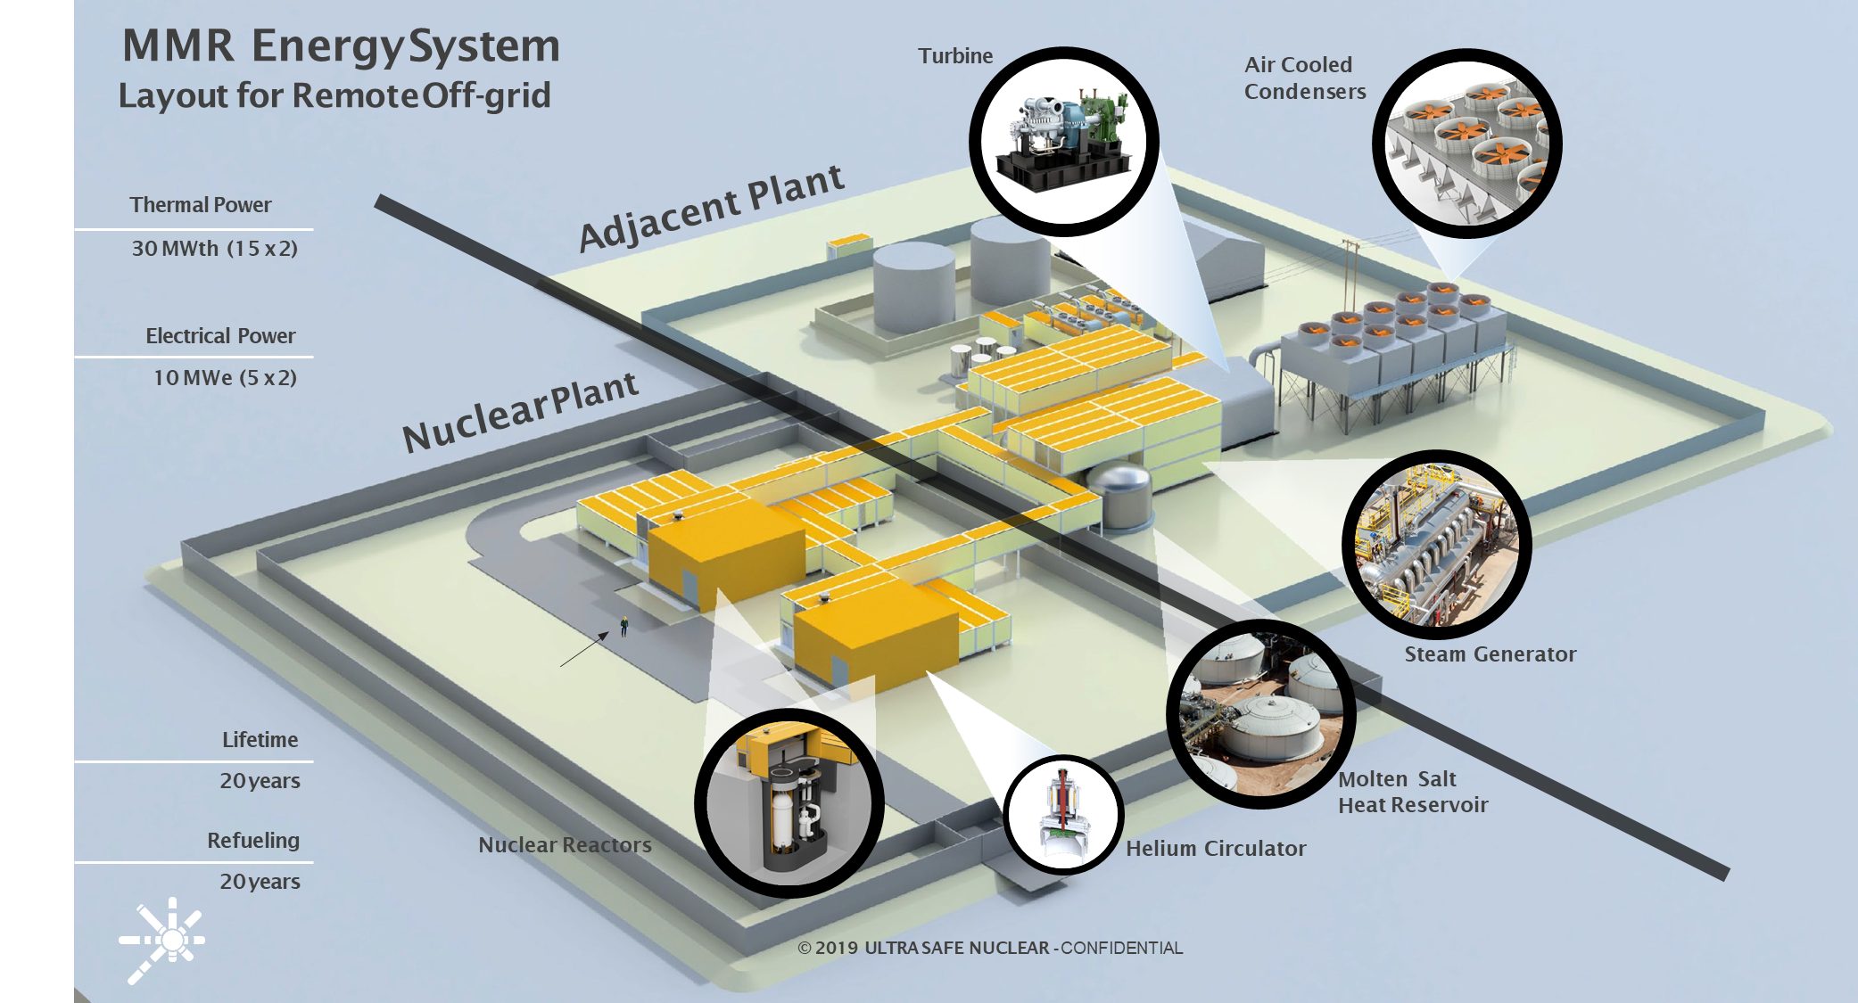
Overview MMR™ Energy System
The MMR™ Energy System is split into a nuclear plant and adjacent plant
Split allow for standard nuclear plant irrespective of application, reduces licensing risks for future deployments
Molten Salt
Decouples the Nuclear Facility
Single phase, High heat conductivity, Chemically stable
Provides Energy storage with increased reliability
Ability to adapt the Adjacent facility to multiple market applications (Power/ Process Heat/ Hydrogen etc.)
Primary circuit - Helium at 630°C
Heat Transferred to Molten Salt – Hot Salt at 565°C
High Temperature Salt enables process heat application in various markets

Slide 4
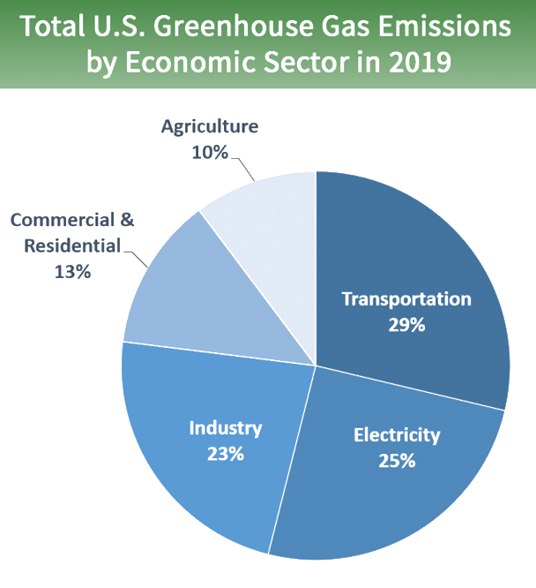
Process Heat Market
Process Heat Sector
US Industry - 23% of annual emissions
Mainly direct fossil fuel combustion
No viable alternatives to Cheap Natural Gas which further delays decarbonization
GHG reduction efforts largely based on energy efficiency initiative
The market is distributed with varying capacity and heat quality requirements
Market size in excess of 400 GW Thermal
Source : JISEA 2016
Source: US EPA 2019
MMR™ Process Heat Applications
CHP for various industrial and mining operations
Direct process heat – high quality steam applications
Decentralized heat generation to meet client specific demands
MMR™ Operating Envelope
Source: Based on EPA 2018 Data

Slide 5
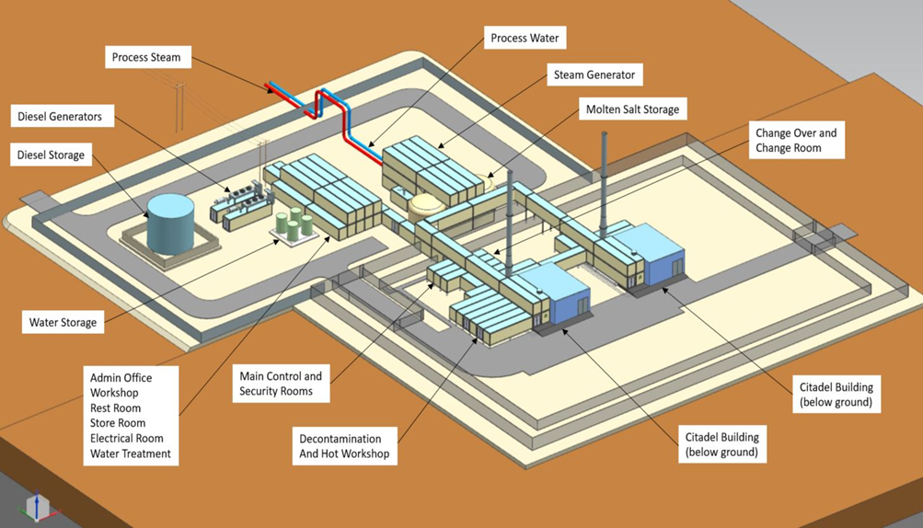
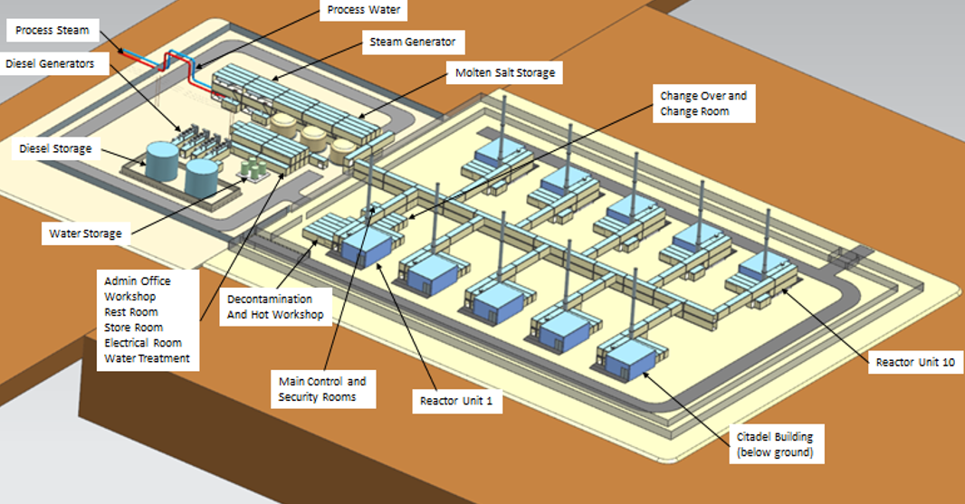
MMR™ Process Heat Applications
Strategic Enablers
High Temperature Molten Salt suitable for several applications
10~20year operation with no refueling
Small size and modular deployment allows for deployment in distributed process heat market
Nuclear Plant based on standardized design – reducing licensing risks
Process Heat equipment and plant will be non-nuclear (standard industrial equipment and QA systems)
GFP believes that the decoupling of the nuclear plant will lower barriers to industry adoption of the MMR™
Limitations of the MMR™
Molten Salt and Reactor Operating Temperature will limit the ability for MMR™ to fully address high temperature process heat market
Low Cost of Fossil Fuel – Particularly Natural Gas makes economic competitiveness challenging, future carbon taxation may accelerate change
Modular approach enables deployment in a variety of settings:
Small Industrial Natural Gas User (30-60 MW thermal) (2 to 4 units)
Large Industry – Refinery (100-300 MW thermal) (10 units and higher)

Slide 6
Timeline- For Planning Purposes
Notes:
Eric
Notes (adjusted from the TTH script):
Now, onto our preliminary project timeline.
If all goes to plan, we expect first power, which is to say when the unit would be first operational, by 2026. There's still a lot of planning to do and many things to consider, so the detailed project schedule is a work in progress right now and will be more fully defined over the next few years, particularly after we have an approved environmental assessment and license to prepare the site - two areas of major focus this year and next. That license is one of several licenses GFP would need over the course of the facility's lifetime.
Meanwhile, we also continue with other activities within GFP the company and this project, things like updates to our corporate policies, exploring terms for service providers, improving our cost estimates, planning out our staffing needs, developing our supply chain model, and from a technical perspective, while USNC is the designer of the reactor, we still have some design to do or oversee with respect to the balance of the nuclear plant and adjacent plants. We're doing this now at a concept phase level, and will be moving to a definition phase level of design later this year.
We have also built in lots of opportunities to engaging with Indigenous communities, public, and stakeholder groups. You'll see that our timeline includes public input throughout all stages; this is very important to us and fundamental to our project's success.

Slide 7
How to get involved
Website: www.globalfirstpower.com Email: info@globalfirstpower.com
Phone: 1-800-892-9504 Twitter: @Global1stPower
Please fill out the comment form online or submit by email
We would appreciate your comments by March 10, 2021
Notes:
ERIC

