Slide 1
Market Insights on How to Get SMR As a Solution for Industrial Applications
07/10/2021

Slide 2
Responsible Designer of the Belgian Nuclear Fleet
60+ years
Responsible designer
28
Countries
PDoel NPP – Belgium / © ENGIE ELECTRABEL / Rudy De Barse
1,000
Employees globally
€180M
Revenues

Slide 3
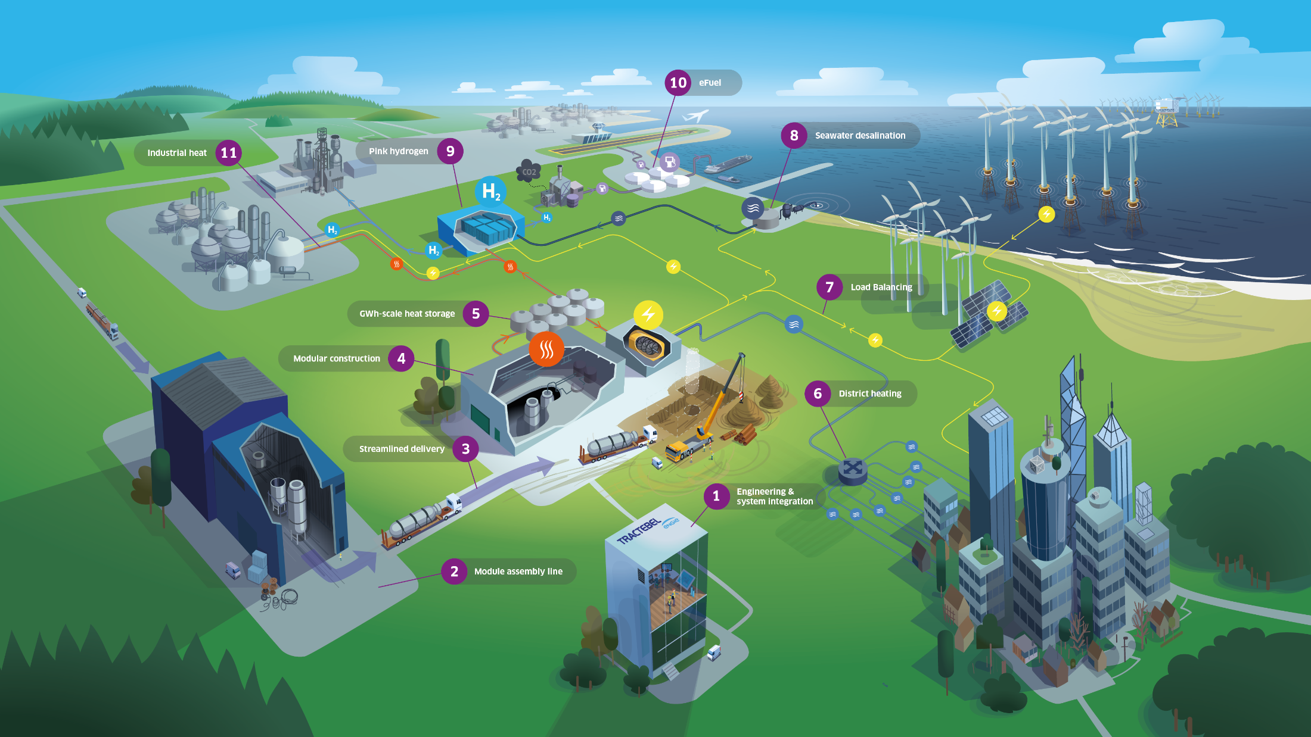
Tractebel’s Vision for Small Modular Reactors
Notes:
So, first question is “what are SMRs and why are they different from previous nuclear concepts?”. This illustration capture most of the answers I will detail with you. And I really need to discipline myself to keep to the essential because there are so much to say that I could spend my entire keynote solely on this image. So, let’s keep it to two key messages:
SMRs are not a single product but rather a new design philosophy that aims to two things
Bringing back nuclear projects within a range of risk (in term of delivery certainty and financial burden) that is compatible with private actor appetite/capabilities. As illustrated on the left side, SMRs are not just smaller reactors, they are on purpose Smaller, Simpler and Standardized Modular Reactors designed in order to streamline the delivery process and reduce associated execution risk.
Extending the reach of market applications: as the market context is changing with the energy transition, we see emerging the need for:
flexible/dispatchable energy source to balance the increasing share of renewable energies and,
For versatile energy solution to address segment of the economy that are difficult to electrify like the heavy industry and long-haul transport
And this materialize in more than 70 concepts internationally at various level of development.

Slide 4
A Success Story for SMR Projects for Industrial Applications Must Meet Top-Down Market Segment and Top-Down Plant Requirements
Market segment size
Theoretical compatibility
Representative plant size
Notes:
For the past 3-4 years has invested significant time and effort trying to understand the SMR “universe”: with technical due diligence, market study and interaction with the overall network of the industry
What I would like to do today is to take you through the most frequently asked questions that we received while exchanging with different market actors: SMR developer of course, but also potential client/off-taker and “facilitator” like public institutions.
And those will be my table of content:
Why consider SMRs and why now ? So why, this time, is it different ? What are the drivers and enablers supporting SMR development?
Where to start ? As the literature on SMR is already overwhelmingly large, were to find reliable information ?
As you may know, more than 70 SMR design co-exist presently. So, how to identify the winning concepts?
Who are the potential clients ? And do they even know it yet ?
As a decision maker, how to ensure it become an option for my business or territory?
And then I will illustrate those insights with two recent references with industrial clients.
Really my objective today is to demystify some of milestones that would lead to an overall SMR strategy and delivery plan

Slide 5
Industrial sectors affinity with SMR-based co-generation Top-down Master Planning
Caption
Max process t°
LWR early adopters
>40 GWth
District Heating
Gen IV early adopter
>20 GWth
Atomistic
Paper
Gen IV late adopter
>10 GWth
<250°C
LWR compatible
Opportunistic
<10 GWth
Refineries
<550°C
MSR Compatible
Ammonia
Soda ash
Chemical clusters
<1000°C
VHTR compatible
Steel
Aluminium
Glass
Ceramic
>1000°C
Top-up heat required
Lime
Cu, Ni
Cement
Reengineering
Top-up heat
Part supply
On-site retrofit
Plug-in
Coupling easiness

Slide 6
A Success Story for SMR Projects for Industrial Applications Must Meet Top-Down Market Segment and Top-Down Plant Requirements
Market segment size
Theoretical compatibility
Representative plant size
Operating Constraints
Local infrastructures
Geopolitics
Notes:
For the past 3-4 years has invested significant time and effort trying to understand the SMR “universe”: with technical due diligence, market study and interaction with the overall network of the industry
What I would like to do today is to take you through the most frequently asked questions that we received while exchanging with different market actors: SMR developer of course, but also potential client/off-taker and “facilitator” like public institutions.
And those will be my table of content:
Why consider SMRs and why now ? So why, this time, is it different ? What are the drivers and enablers supporting SMR development?
Where to start ? As the literature on SMR is already overwhelmingly large, were to find reliable information ?
As you may know, more than 70 SMR design co-exist presently. So, how to identify the winning concepts?
Who are the potential clients ? And do they even know it yet ?
As a decision maker, how to ensure it become an option for my business or territory?
And then I will illustrate those insights with two recent references with industrial clients.
Really my objective today is to demystify some of milestones that would lead to an overall SMR strategy and delivery plan

Slide 7
Sequence to succeed in new projects Getting SMRs as an option for Industrial Applications: starting point
Assemble project partners and align on overall project story
Analyze all options deemed to be of interest, screen them and aim at choosing an only to be developed during the Feasibility
Build-up on the most appropriate solution that has been extracted during PFS. Launch additional (survey) campaigns before FEED.
Provide the entire technical, commercial, legal permit, economic, operational, project and contractual requirements to enable partners to confirm FID of the development.
Deliver on time, on budget and on specifications the project designed within Front End Loading activities
Objective
We are here
Inception
Pre-feasibility
Feasibility
FEED
Execution
Deliverables
Master Plans
Candidate sites
Inception report
Stage-gated delivery plan
Suitability requirements
Operating constraints (availability, reliability, temperature regime…)
Siting and layout requirements
SMR design screening
Compatibility with requirements
Candidate or representative design selection
System integration
Technical interface management
Site specific layout influence
Business case demonstration
Stakeholders structure
Offtake strategy
Finance & premium opportunities
Activities

Slide 8
Coal retrofit with SMR in Poland
Sites assessment of two coal power plants in Poland for suitability of retrofitting with SMR solution
Client | Synthos Green Energy SA
Location | Poland
Period | 2020 – on-going
Services provided | Site description - First assessment of site suitability Plant description - Understand and assess the existing plant: Systems and components Plant output and performance Residual lifetime and environmental permits Layout End-User requirements and constraints Scenarii definition & comparative assessment and recommendation for executable SMR solution
Notes:
On the other hand: “bottom-up” demands can emerge like in Poland with Synthos Green Energy, a project developer that asked us to asses the feasibility of repurposing two existing coal power plans with SMRs.
A brownfield exercise that looked on how to leverage the existing infrastructure of the fossil asset.

Slide 9
Small Modular Reactor Pre-feasibility for Industrial Applications
Pre-feasibility guidance for SMRs as an option to decarbonize two chemical production assets (US & EU)
Client | MAJOR ACTOR IN CHEMICAL INDUSTRY
Location | US & EU
Period | 2021 – on-going
Services provided | Definition of suitability requirements for the two chemical assets SMR technology evaluation and down-selection System integration and project specific design Roadmap For SMR Deployment

Slide 10
To deep-dive the question of SMRs Tractebel White Paper https://tractebel-engie.com/files/attachments/.3456/Tractebel-The-rise-of-nuclear-technology-2-0.pdf
Chapter 1 - The vibrant international race for Advanced Nuclear
Chapter 2: Beyond Baseload electricity production
Chapter 3: European Heat Market
Chapter 4: Low-carbon Hydrogen for eMolecules
Notes:
To deep-dive these concepts, we have recently published a White Paper. We have written it purposely concise and accessible to be a good entry door to people not yet acquainted with SMRs.
It is a digest, a summary of the technical assessments and market studies we have performed during the last three years and it contains also our own vision and position regarding the future of SMRs.
It is publicly available through the link in the title or via the QR code on the cover.
It is composed of 4 chapters:
Chapter 2, 3 and 4 look at the three main emerging market applications. Namely flexible electric production, direct use of process heat in the heavy industry and hydrogen & eFuel production
And Chapter 1 gives a comprehensive overview of the SMR design drivers and current market trend
And one of the thing you will discover in that chapter if you don’t know it yet is that there are currently more than 70 concepts under development worldwide…

