Slide 1
The NEA
Nuclear Data Sensitivity Tool NDaST
J.Dyrda, I.Hill, N.Soppera, M.Bossant
GENTLE intersemester course – EC-JRC Geel, Belgium
14 - 18 November 2016

Slide 2
Overview
This is a presentation designed to give a starter’s introduction to the main features of NDaST and basic instructions for its use
What is it exactly?!
NDaST is an analysis tool to propagate the impact of changes in nuclear data cross sections and of nuclear data covariance to benchmark uncertainties.

Slide 3
Background
How and why did this come about?
There was existing Sensitivity Data in DICE (Database for ICSBEP) and IDAT (Database for IRPhEP)
This could be ‘viewed’ or used to select or order benchmarks, but little further application
No means to link DICE and integral benchmarks to nuclear data or JANIS – expand or build specific tool?
The Nuclear Data Sensitivity Tool (NDaST) was developed in 2015 to accomplish this
It has already seen application use in the CIELO and JEFF nuclear data projects and SFR benchmark

Slide 4


Database for ICSBEP [DICE] Sensitivity Data Status
Handbook Edition | Number of Unique Cases | Sources
2012 | 727 | TSUNAMI1D+TSUNAMI3D [VALID]+ MMK-KENO
2013 | 3575 | Previous + Non VALID cases SCALE6.0 from Balance Inputs
2014 | 4011 | Previous + MCNP6 + SCALE6.2BClutch
2015 | 4065 | Previous + New Cases
2016 | ~4200 | Previous + New Cases + P1 Sensitivities [~400 cases]
DATABASES WITH SENSITIVITY PROFILES
Sensitivities (S) & C/E data
DICE
2015 | THERM | INTER | FAST | MIXED
PU | 525/608 | 4/10 | 114/121 | 9/9
HEU | 664/895 | 21/32 | 383/403 | 75/84
IEU | 142/180 | 5/21 | 31/43 | 7/23
LEU | 1424/1612 | 0/0 | 1/1 | 5/5
U233 | 186/197 | 29/29 | 8/10 | 8/8
MIX | 323/436 | 2/7 | 40/67 | 1/26
SPEC | 0/0 | 0/0 | 4/20 | 0/0

Slide 5
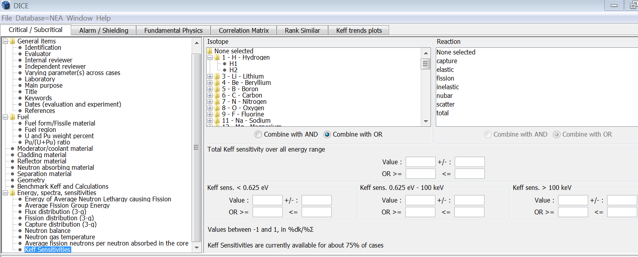
DICE k_{eff} Sensitivities Search
3 Group search, full 238 Group SDF’s are stored and freely accessible. NB. Access to evaluations and input decks are restricted to NEA member countries and participating organisations.
Set Threshold
Negative over here
Also useful!

Slide 6
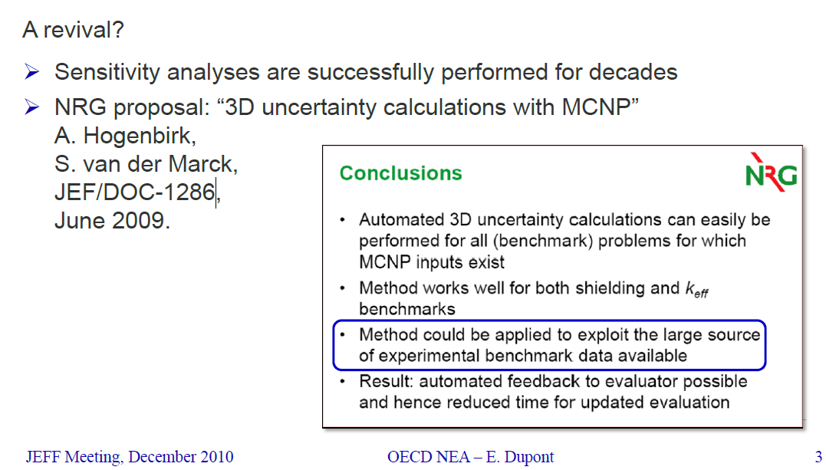
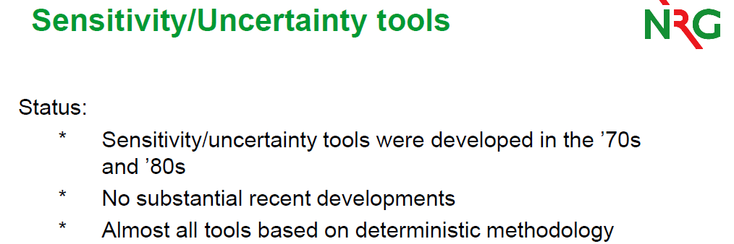
Integrating Sensitivity Data With Nuclear Data
  Idea: Potential scoping tool that leverages sensitivity data to make rapid predictions of the integral responses to changes in nuclear data.
    Changes and trends in Δk_{eff} for broad nuclear data perturbations
    Propagation of nuclear covariance data to benchmark C/E results
  Integral Data Sources: Criticality (DICE), Reactor Physics (IDAT), Spent fuel (SFCOMPO), Numerical / computational benchmarks, Shielding (SINBAD).
  Nuclear Data: Evaluated nuclear covariance data files are accessible via the NEA JANIS application
5 years later, NDaST went into development.
Contact james.dyrda@oecd.org

Slide 7


Nuclear Data Sensitivity Tool (NDaST) Flowchart
Benchmarks (Sensitivities) → Nuclear Data (% Change or Covariance) → Integral Results
Select / load benchmarks
Sensitivities (S) & C/E data
DICE
IDAT
Personal
Numerical Benchmarks
User Input Perturbation (P)
isotope/reaction/energy cross section
S*P
Δk_{eff} for selected cases
C/E output plot grouped by criteria
Covariance data via JANIS (C)
Built in processed data for major libraries
Load personal (coverx)
M energy groups (fixed)
S*C*S^{T}
U_{C(XS)} for selected cases
Additional uncertainty on output plot grouped by criteria
Matrix plot showing individual contribution to U_{C(XS)} by isotope-reaction
AND/OR
JANIS MF33: ENDF/B-VII.1 = 2138 files, JEFF-3.2 = 5688 files JENDL-4.0 = 2155 files TENDL-2013 = 77811 files

Slide 8
Contents
Introduction, means of use, benefits & limitations…
Loading benchmark sensitivities and results
Inputting nuclear data perturbations
Launch, visualise and interpret results
Class exercise 1 – steps 2, 3 & 4
Adding covariance matrices to the calculation
More visualisation possibilities
Future developments to be made
Class exercise 2 – try out steps 5 & 6

Slide 9
Launching the Software
NDaST is another JAVA based tool and feels very similar to those already seen
It’s free, there’s no password and is run by launching from the NEA website
  www.oecd-nea.org/ndast/
Your DICE and IDAT settings will be reused
Any personal ‘bases’ you have loaded into JANIS can be connected for use
Computational load on your computer is minimal – designed to let NEA servers bear the brunt, while you reap the benefits!

Slide 10
Depending on What You Want Benchmarking Can Be Computer Intensive
Days
To assess the impact on all PU-SOL-THERM
→ Run 600 Benchmarks, k_{eff} 5 pcm
To assess the impact of each reaction on the benchmarks
→ 600 X #Reactions [Look what is driving the k_{eff} change]
To assess the impact of each reaction and each energy range on the benchmarks
→ 600 X #Reactions X #Energies [Look at energy region driving the change]
To decide between different options in each reaction and energy
→ 600 X #Reactions X #Energies X #Options
Months
Years
Decades
Example: 10 h per run, 5 reactions, 10 energy groups, 5 options
= 600 X 10 h X 5 X 10 X 5 = 1.5 Million Computer Hours or 171 Computer Years! (per isotope ☺)
Attempt to reduce this to minutes!

Slide 11
Benefits
Goal: Given a new nuclear data evaluation, provide evaluators and other users a tool to see how the changes they’ve made will impact integral benchmarks…in minutes.
See individual reaction effects, not just final totals
Analyse how these ‘compete’ if they are correlated
Understand specifically which energy regions matter
How do perturbations compare with given uncertainties
Propagate uncertainties and judge their reasonability
Do this time and time again as small iterations take place
Allow internationally co-operating projects to manage these processes more easily

Slide 12
Limitations
All based on simple, first order approximations
  These might not hold beyond certain limits, depending on strength of secondary effects
Not all cases (around 85% of the total database)
Sensitivities mostly the SCALE 238 group energy structure
  Bad choice for certain types of systems & perturbations e.g. movement of large resonances across group boundaries
Reactions (not all are loaded into database)
  Difficult to properly handle the energy-dependent PFNS
Angular sensitivity (being addressed – 400 P1 sensitivities)
Experimental correlations are not considered
  This is not (yet) an adjustment tool

Slide 13
Intended Scientific Value
NDaST is a complement to, not a replacement for integral benchmark testing, by actually making code runs – it is invaluable to do this, but on a less frequent basis
You will see approximated results, suitable for general trending and broad conclusions – more data, of lower accuracy can help to focus more precise efforts
However, it should offer a practical alternative means to more quickly optimise new libraries and allow evaluators to make better informed decisions

Slide 14

A very tenuous historical comparison (forgive me!):
“Kepler's laws, although not rigidly true, are sufficiently near to the truth to have led to the discovery of the law of attraction of the bodies of the solar system.
The deviation from complete accuracy is due to the facts, that the planets are not of inappreciable mass, that, in consequence, they disturb each other's orbits about the Sun, and, by their action on the Sun itself, cause the periodic time of each to be shorter than if the Sun were a fixed body, in the subduplicate ratio of the mass of the Sun to the sum of the masses of the Sun and Planet; these errors are appreciable although very small, since the mass of the largest of the planets, Jupiter, is less than 1/1000th of the Sun's mass.”
― Isaac Newton,
The Principia: Mathematical Principles of Natural Philosophy

Slide 15
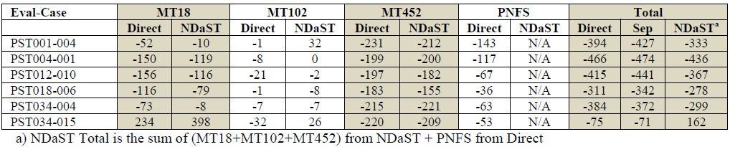
Some Results of Swapping Files, vs Summing the Separate Effect and NDaST
Limitation; CIELO files contain an energy dependent PFNS
Existing NDaST and underlying sensitivity data currently use an energy independent PFNS
PST034-015 is complicated by its intermediate sensitivity, plus coincident shifts in resonances. Also high Gd poison content.
See latest ANS proceedings for Ian Hill’s full paper

Slide 16
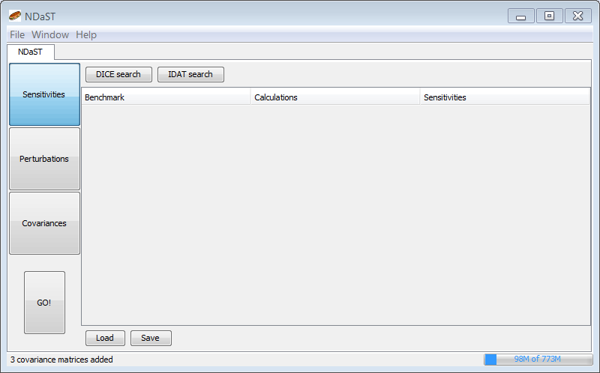
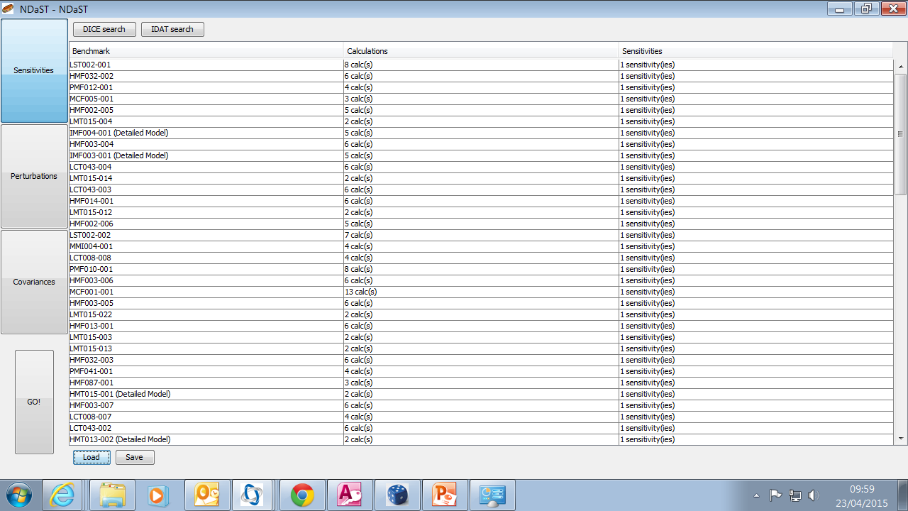
Panel 1: Select Benchmark Sensitivity Data
Currently can select benchmarks via DICE and IDAT plug-ins.
  Search using all the usual DB attributes
  Modify the results or add personal case results & sensitivity data
  ‘Create’ your own personal benchmark
  Save/load custom benchmark suite e.g. CSEWG
      Enable sharing of editable xml file datasets for collaborators / inter-comparisons

Slide 17
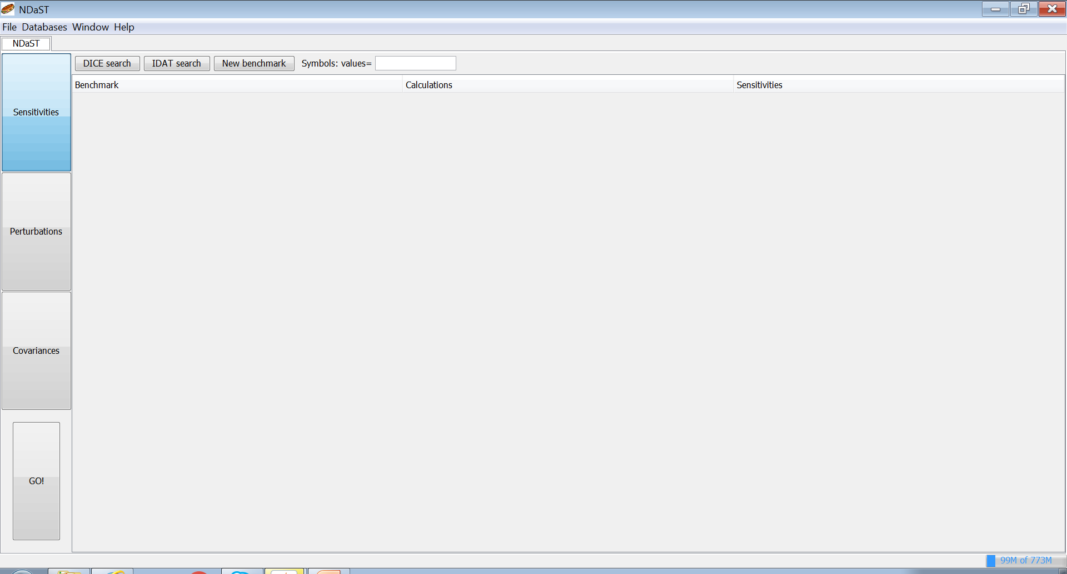
Panel 1: Select Benchmark Sensitivity Data
Panels can actually be filled in any order
Only panel 1 is mandatory
But either panel 2 or panel 3 must contain something
Three current means to load cases to be calculated:
2 are search based from databases (DICE & IDAT)
1 is free input, requiring your own sensitivity data file

Slide 18
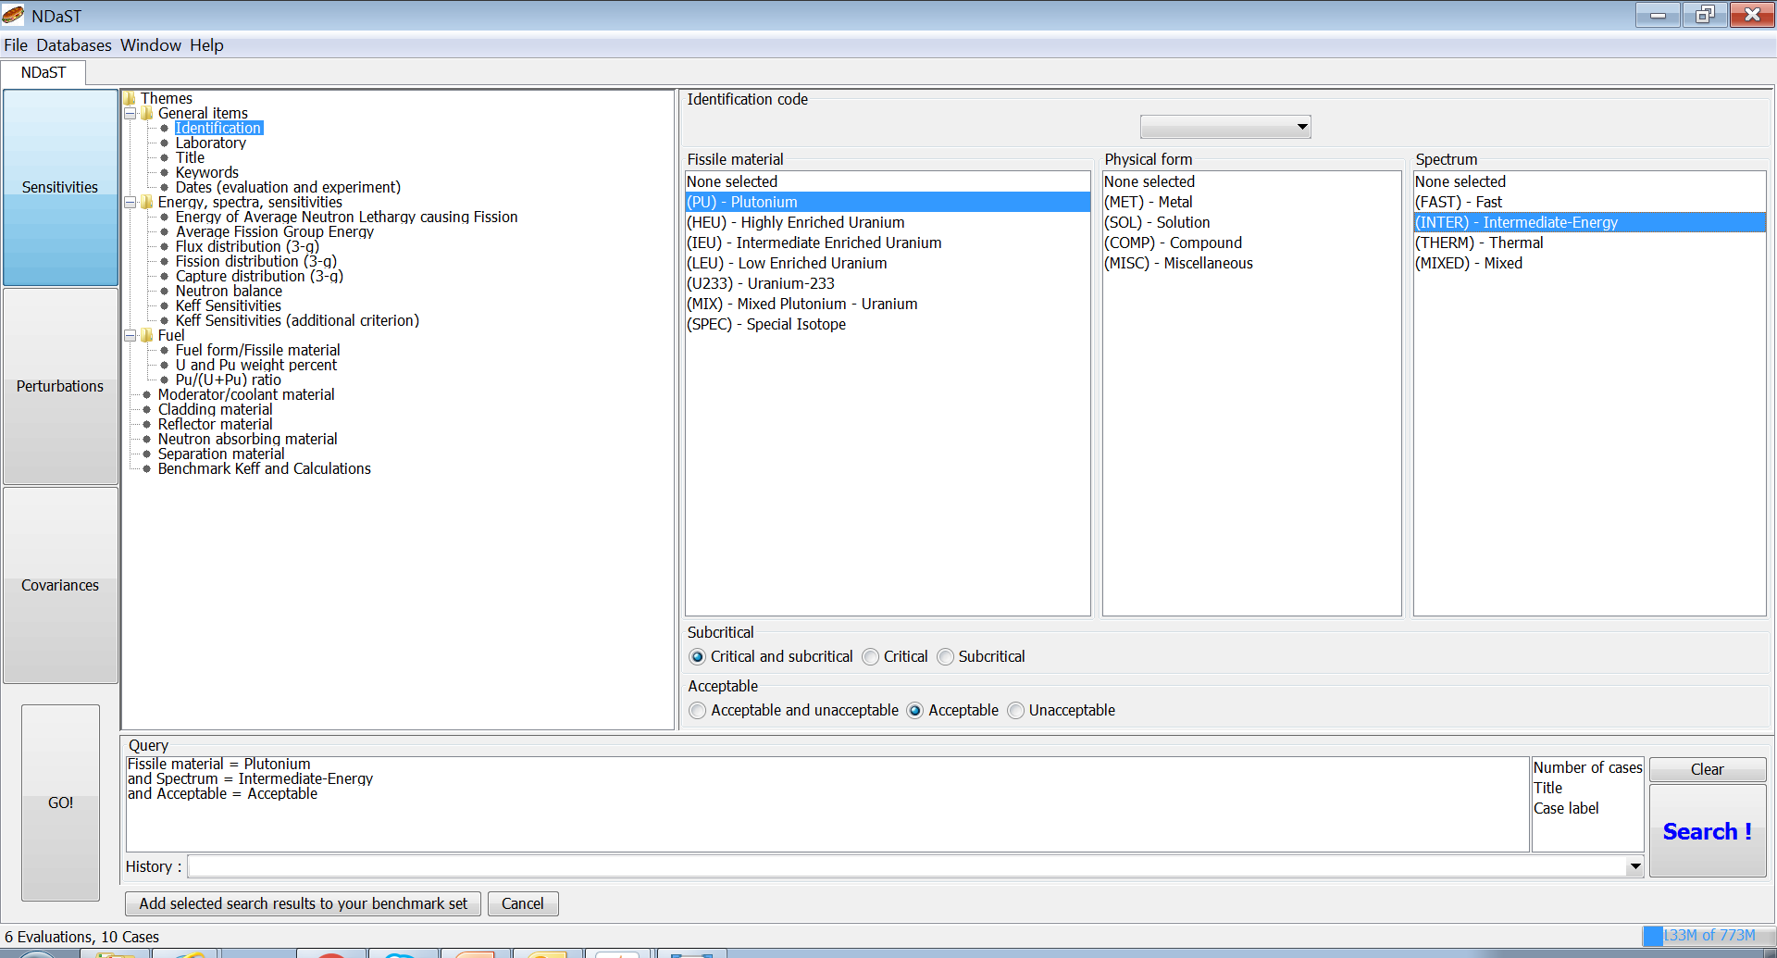
Simple Benchmark Selection - ID
Counter is live before you hit Search button

Slide 19
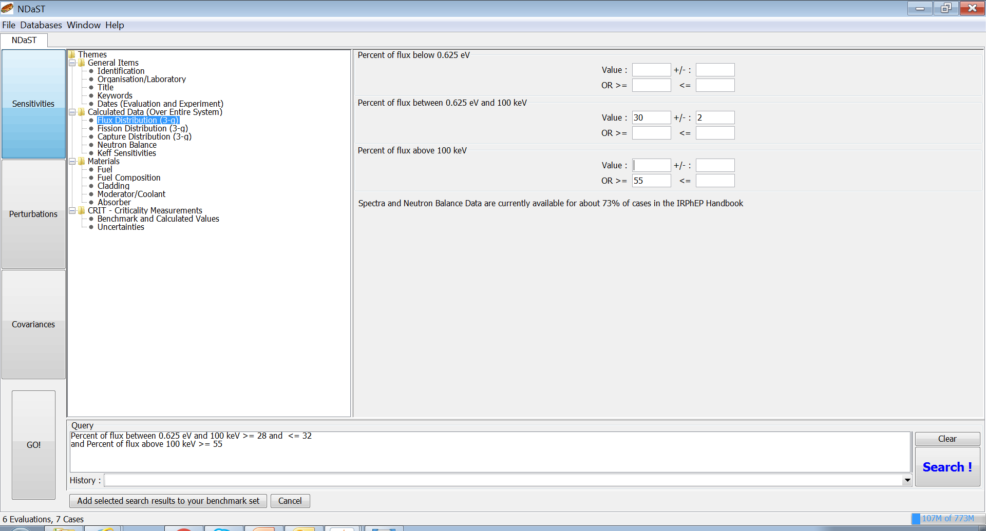
Simple Benchmark Selection - Flux
More specific searches can be performed, normally combined with AND logic operations

Slide 20
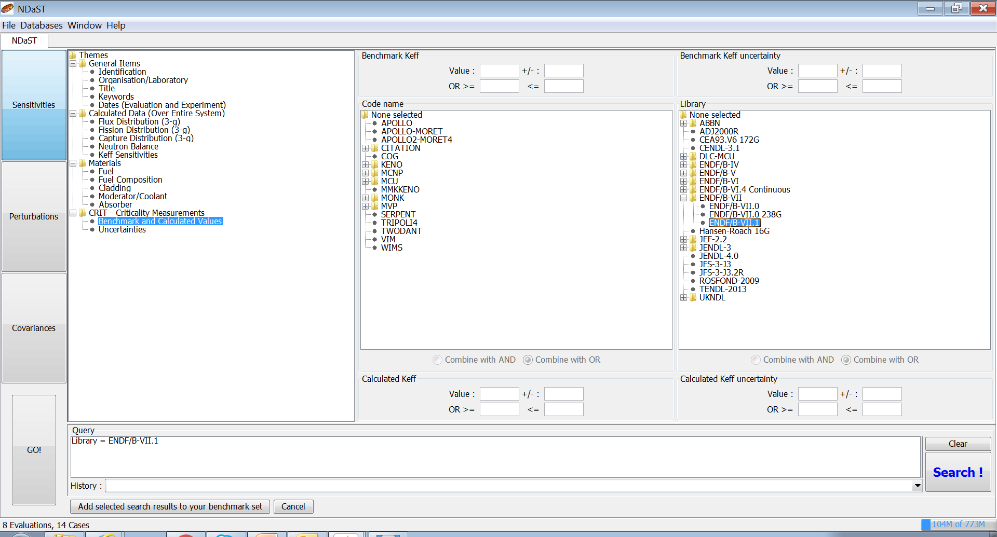
Simple Benchmark Selection - Library
Calculations provided generally within the evaluations are held as C/E data

Slide 21
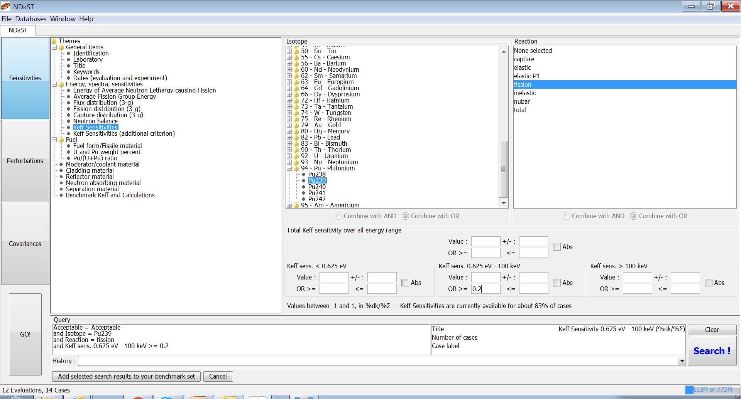
Sensitive Benchmark Search
This is where NDaST is really focused!

Slide 22
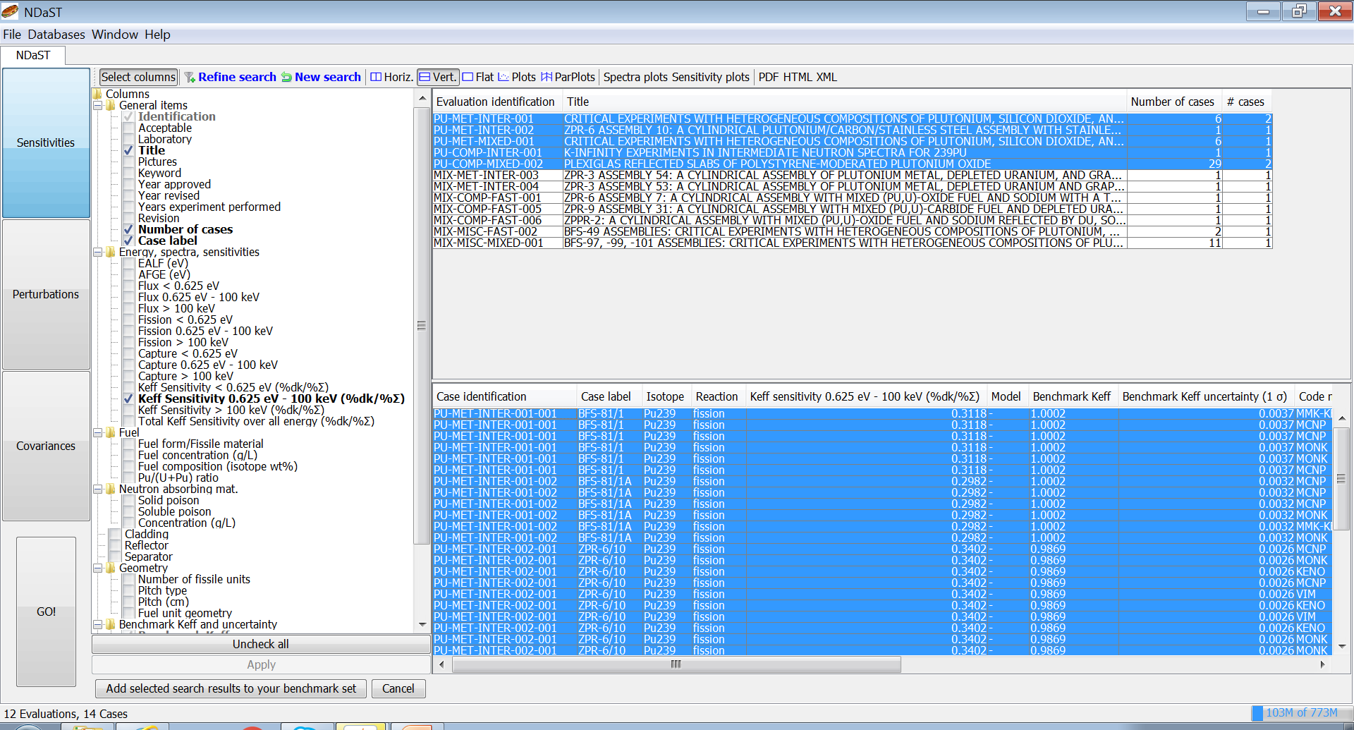
Addition of Benchmarks to Set
Tip: Order your table and use Ctrl+click or Ctrl+a

Slide 23
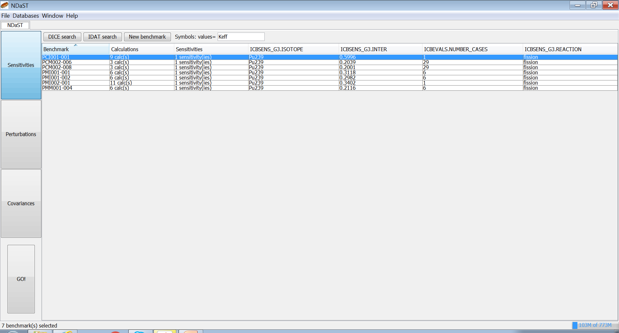
Addition of Benchmarks to Set
This is just a summary table of everything retrieved from the search
The actual data can be viewed and modified by double-clicking on an entry

Slide 24
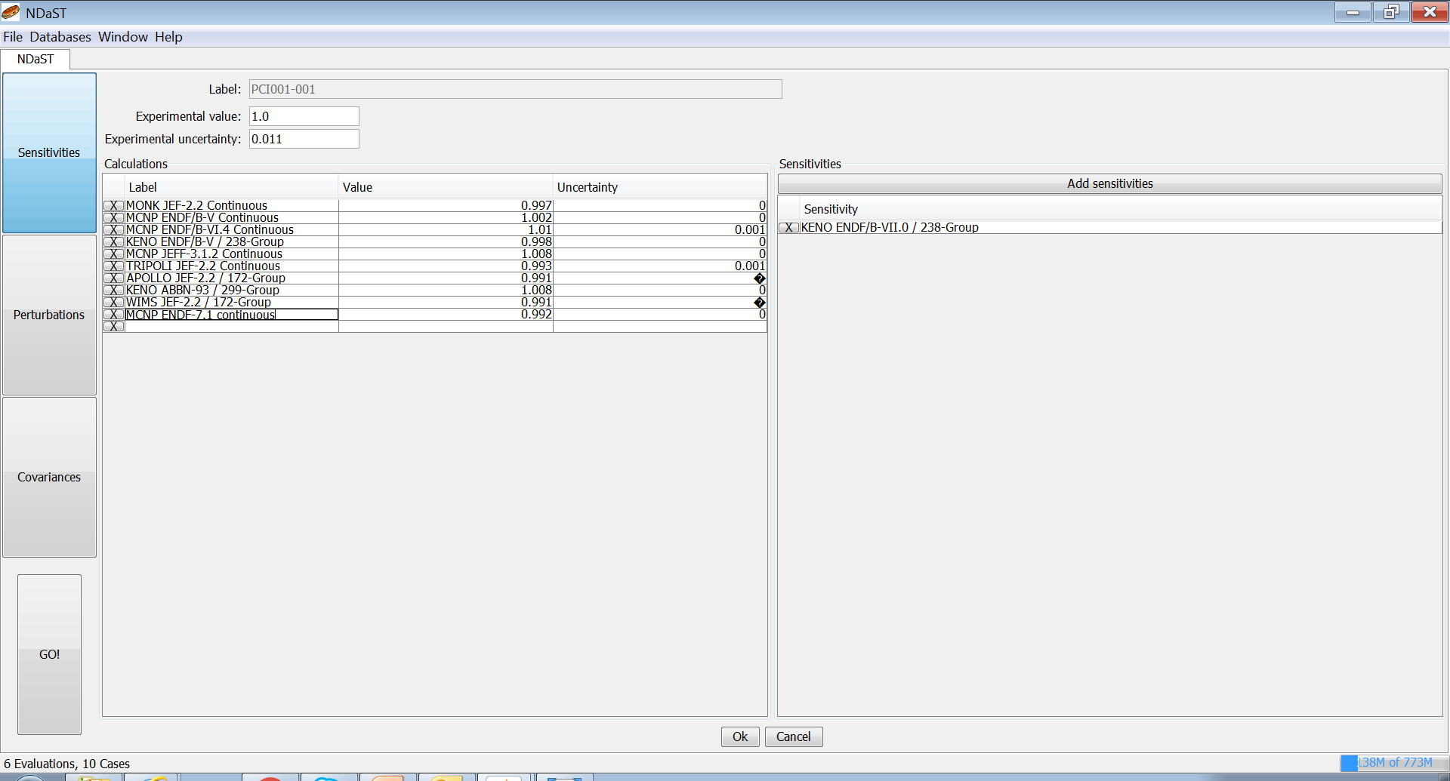
Edit Benchmark Data
If the C/E results and trends are important to you, most likely you’ll want to input your own for comparison
Sensitivity data has, for the most part, been shown to be not highly dependent on the ND library used

Slide 25
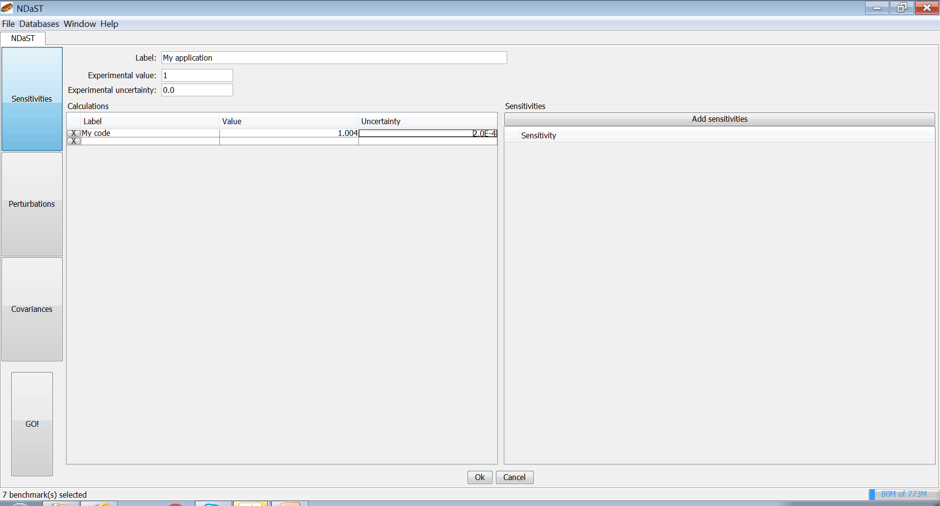
Add ‘New Benchmark’
Particularly useful if you want to compare some application of your own
Or if you have an analytical or computational benchmark

Slide 26
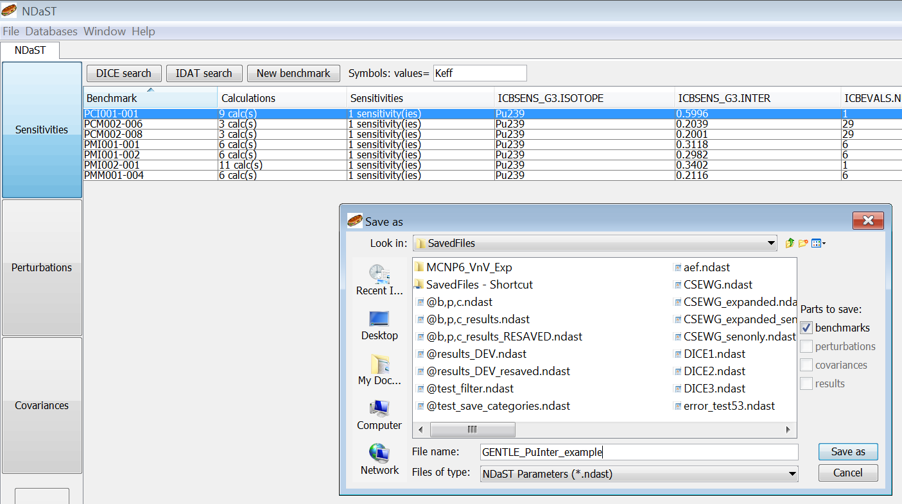
Save and Load Options

Slide 27
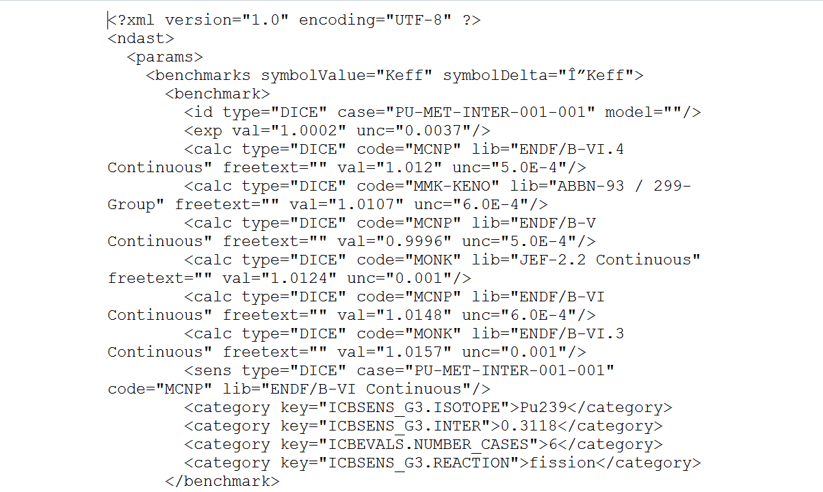
Editable xml File
Consult your ‘How To NDaST’ guide for format

Slide 28
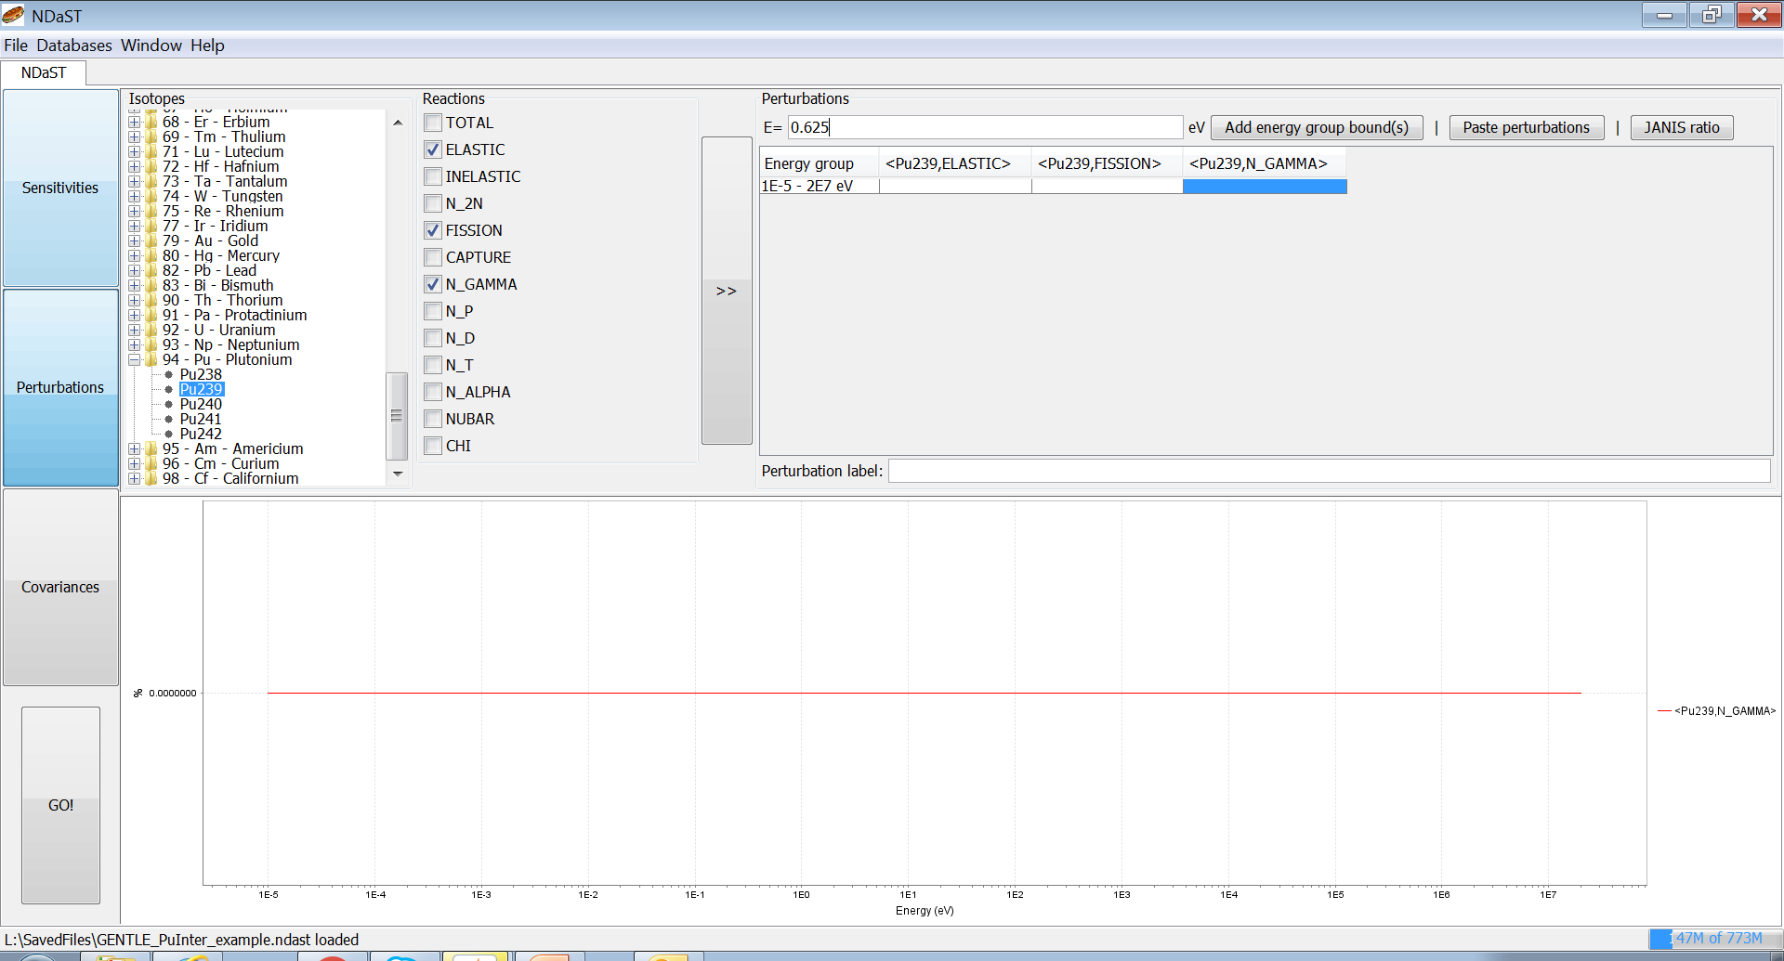
Panel 2: Isotope-Reaction-Energy Perturbations
Each isotope-reaction represented by a column with N energy group rows
Loading Options:
Manually
Copy/paste e.g. from file
Auto-computed by dividing 2 evaluated files (via JANIS) Example:
CIELO ÷ ENDF/B-VII.1
Save in isolation or with panel 1 benchmarks

Slide 29
Add Energy & Perturbation Manually

Slide 30
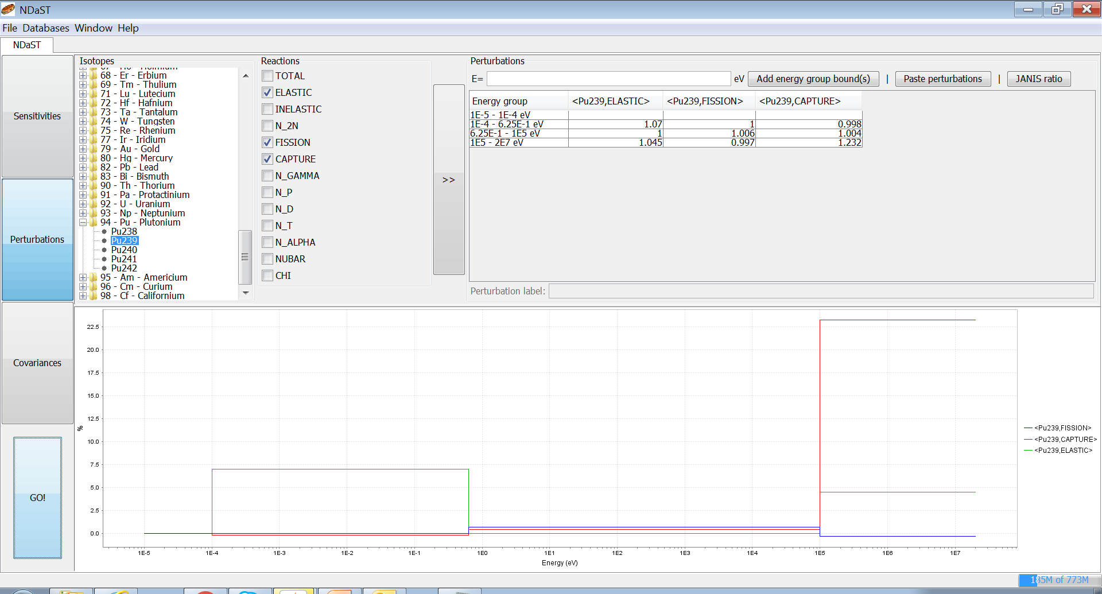
Add Energy & Perturbation Manually
Mix and delete energies – code will logically extend or unionise

Slide 31
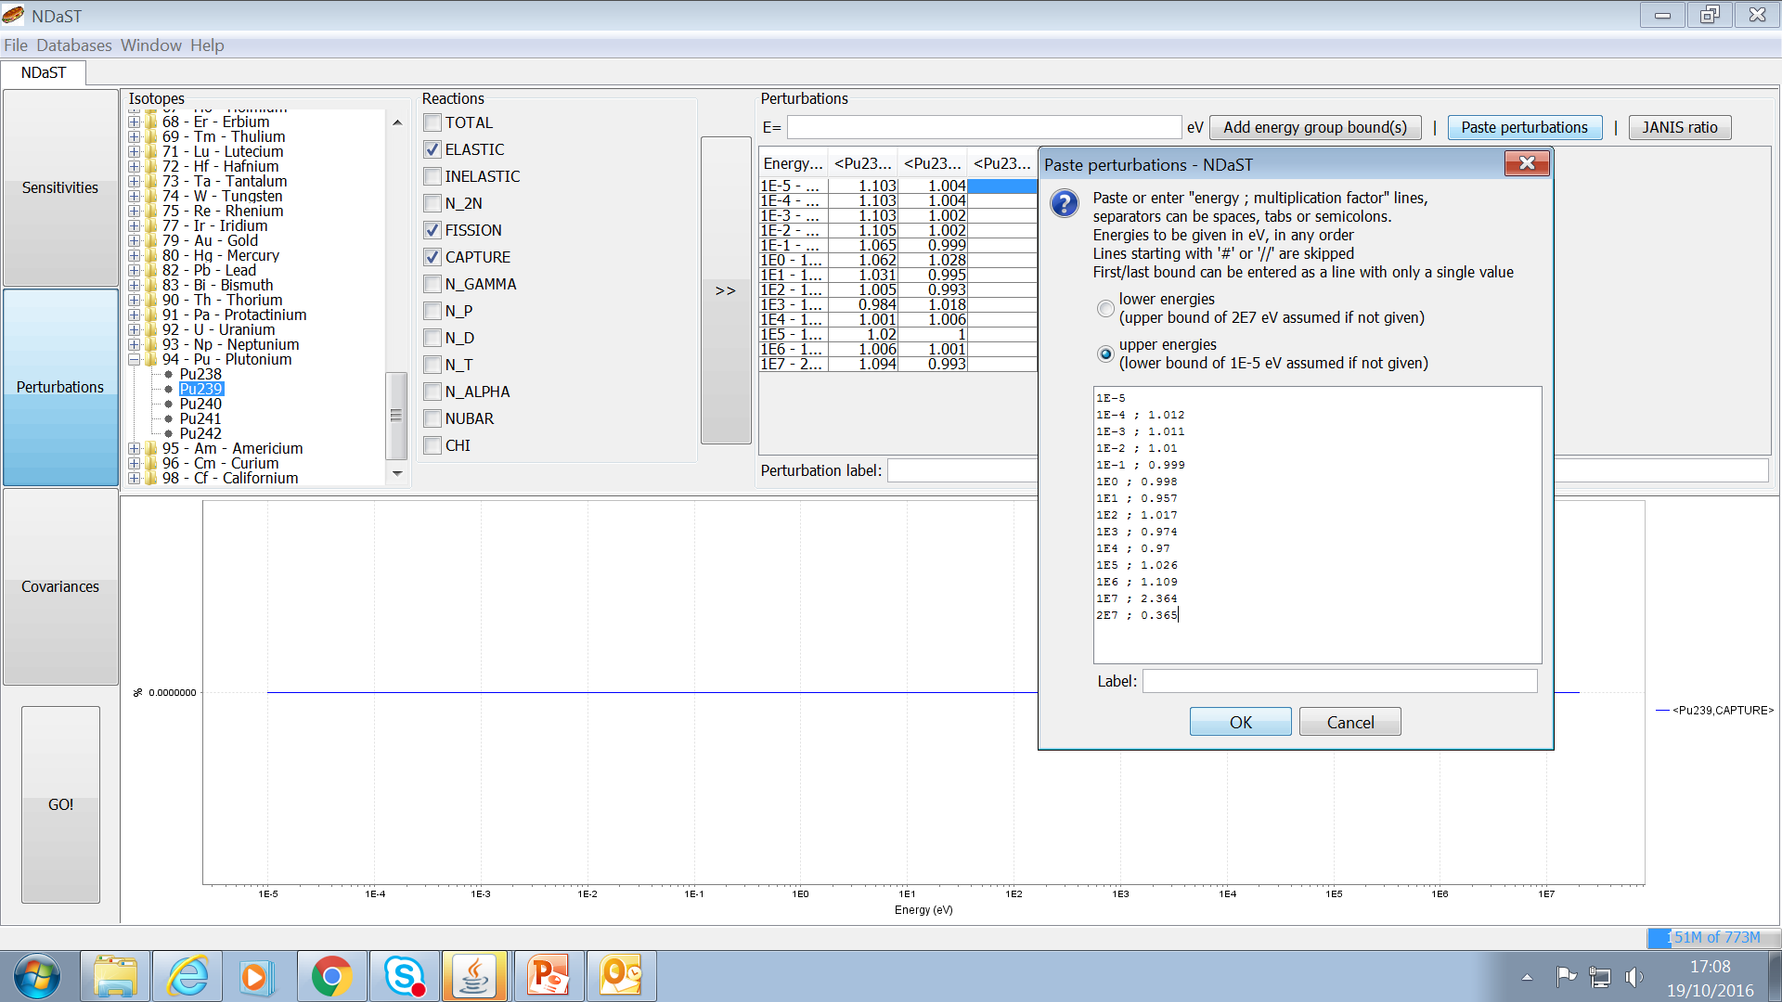
Paste Energies & Perturbations

Slide 32
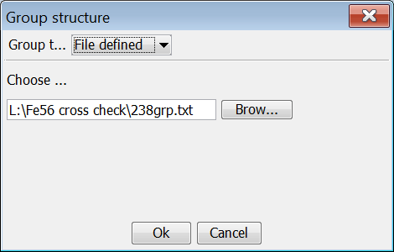
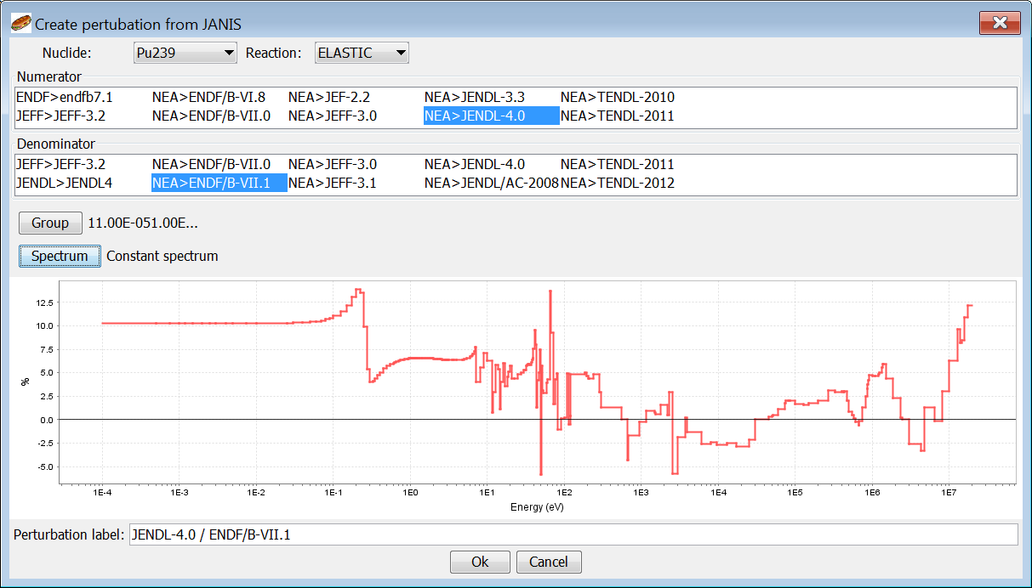
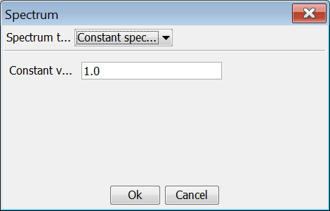
Computation of Ratios in JANIS

Slide 33
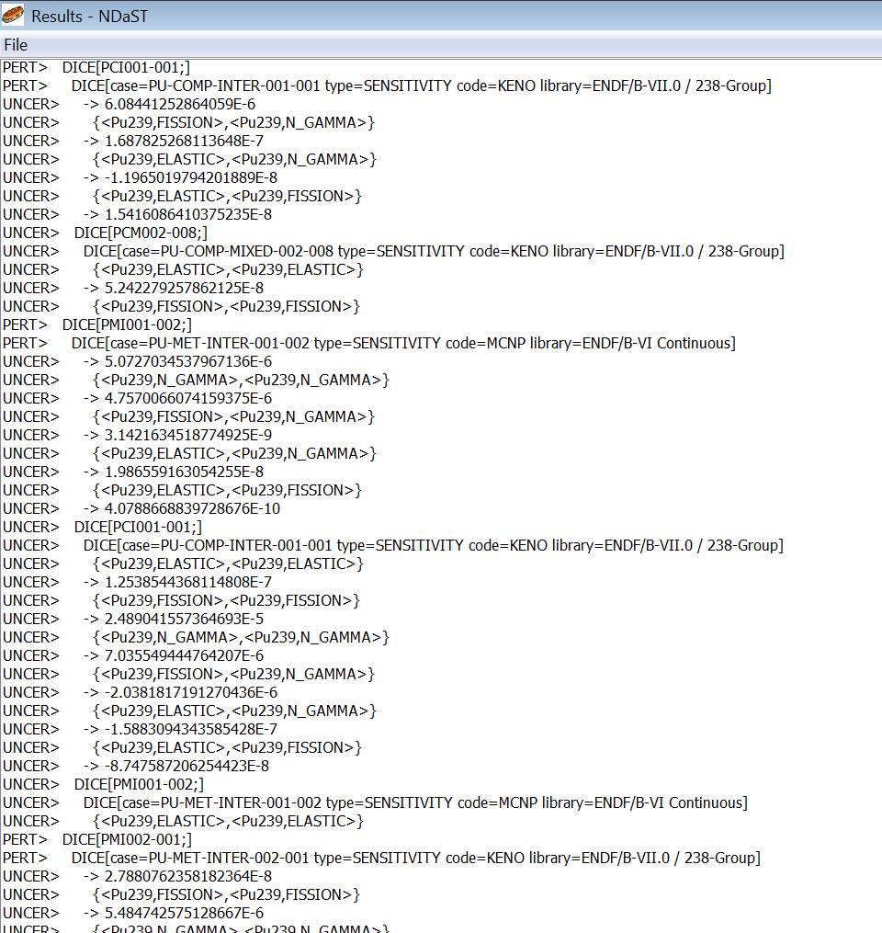
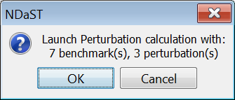
Launch Perturbation Calculation

Slide 34
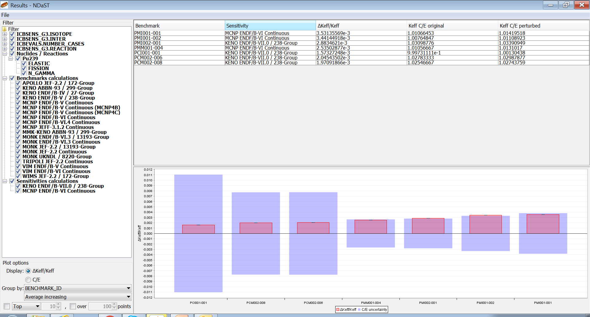
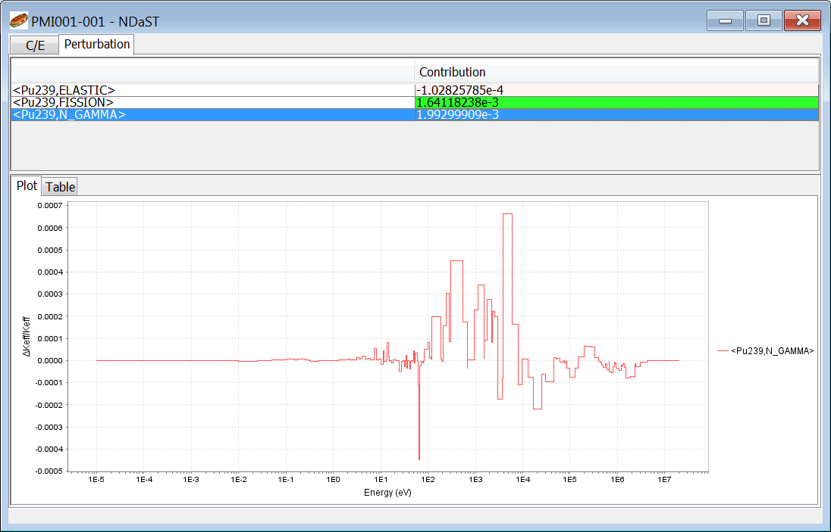
Output Window and Plots (1)
Window with results table of Δk_{eff}/k_{eff ,} original & perturbed mean C/E
Filter tree to the side – dynamic inclusion by nuclide, reaction, fuel, code…
Grouped plot below – toggle either Δk_{eff} or C/E
Grouping and sorting options, plus tool-tip data for the plot
Detail pop-up to see complete data behind each benchmark in the table
  Nuclide-reaction breakdown of total Δk_{eff}
  Individual C/E for all results loaded to that case
  Energy breakdown of Δk_{eff}

Slide 35
Delta k_{eff} Output and Plot
Remove / include branches or leaves of the filter tree;
table and plot update dynamically so you can copy & paste the individual results you need

Slide 36
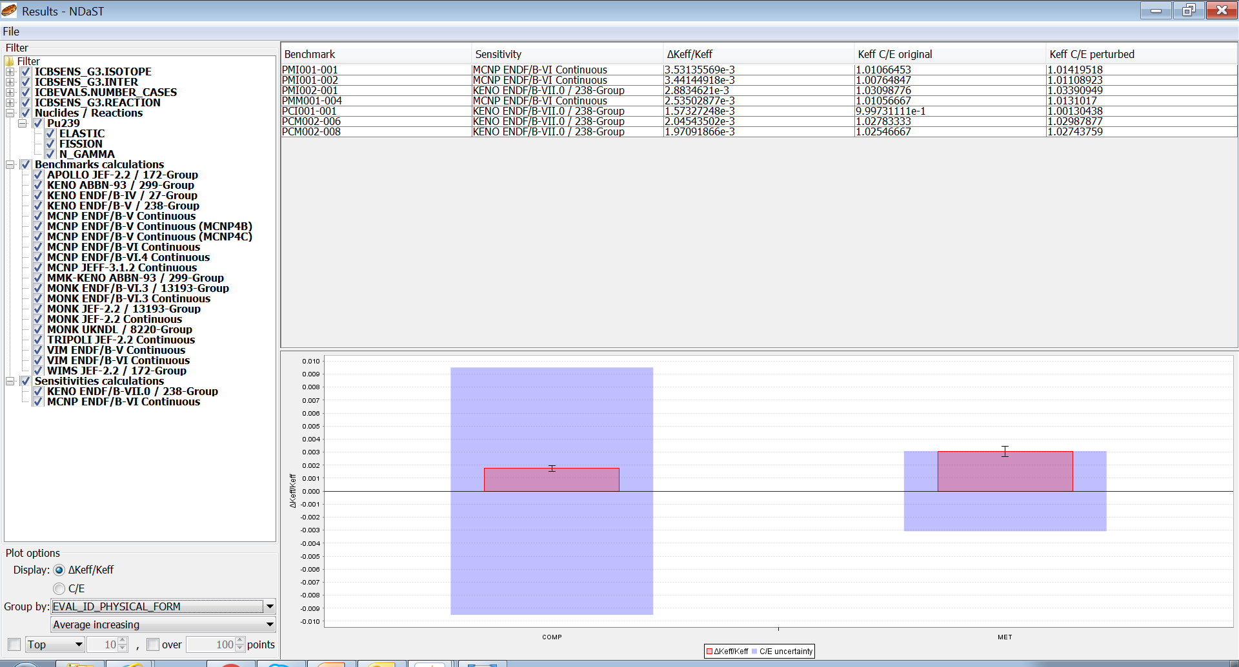
Delta k_{eff} Output: Physical Form
Plot bars can be grouped by a fixed set of shared attributes – to be expanded in future

Slide 37
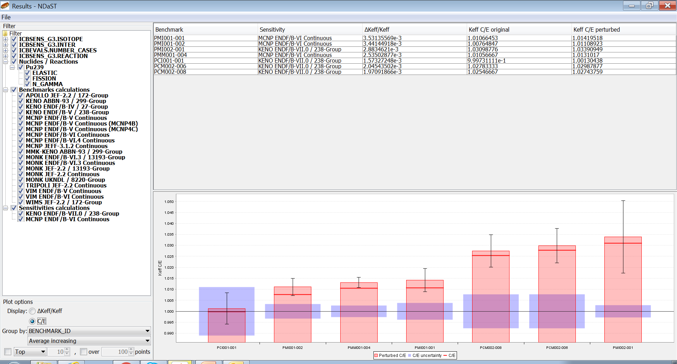
C/E Output Plot: BM ID
C/E plot shows not just the change, but the new expected values of calculations
Including diverse results tends to increase the s.d. of the distribution (black error bar)

Slide 38
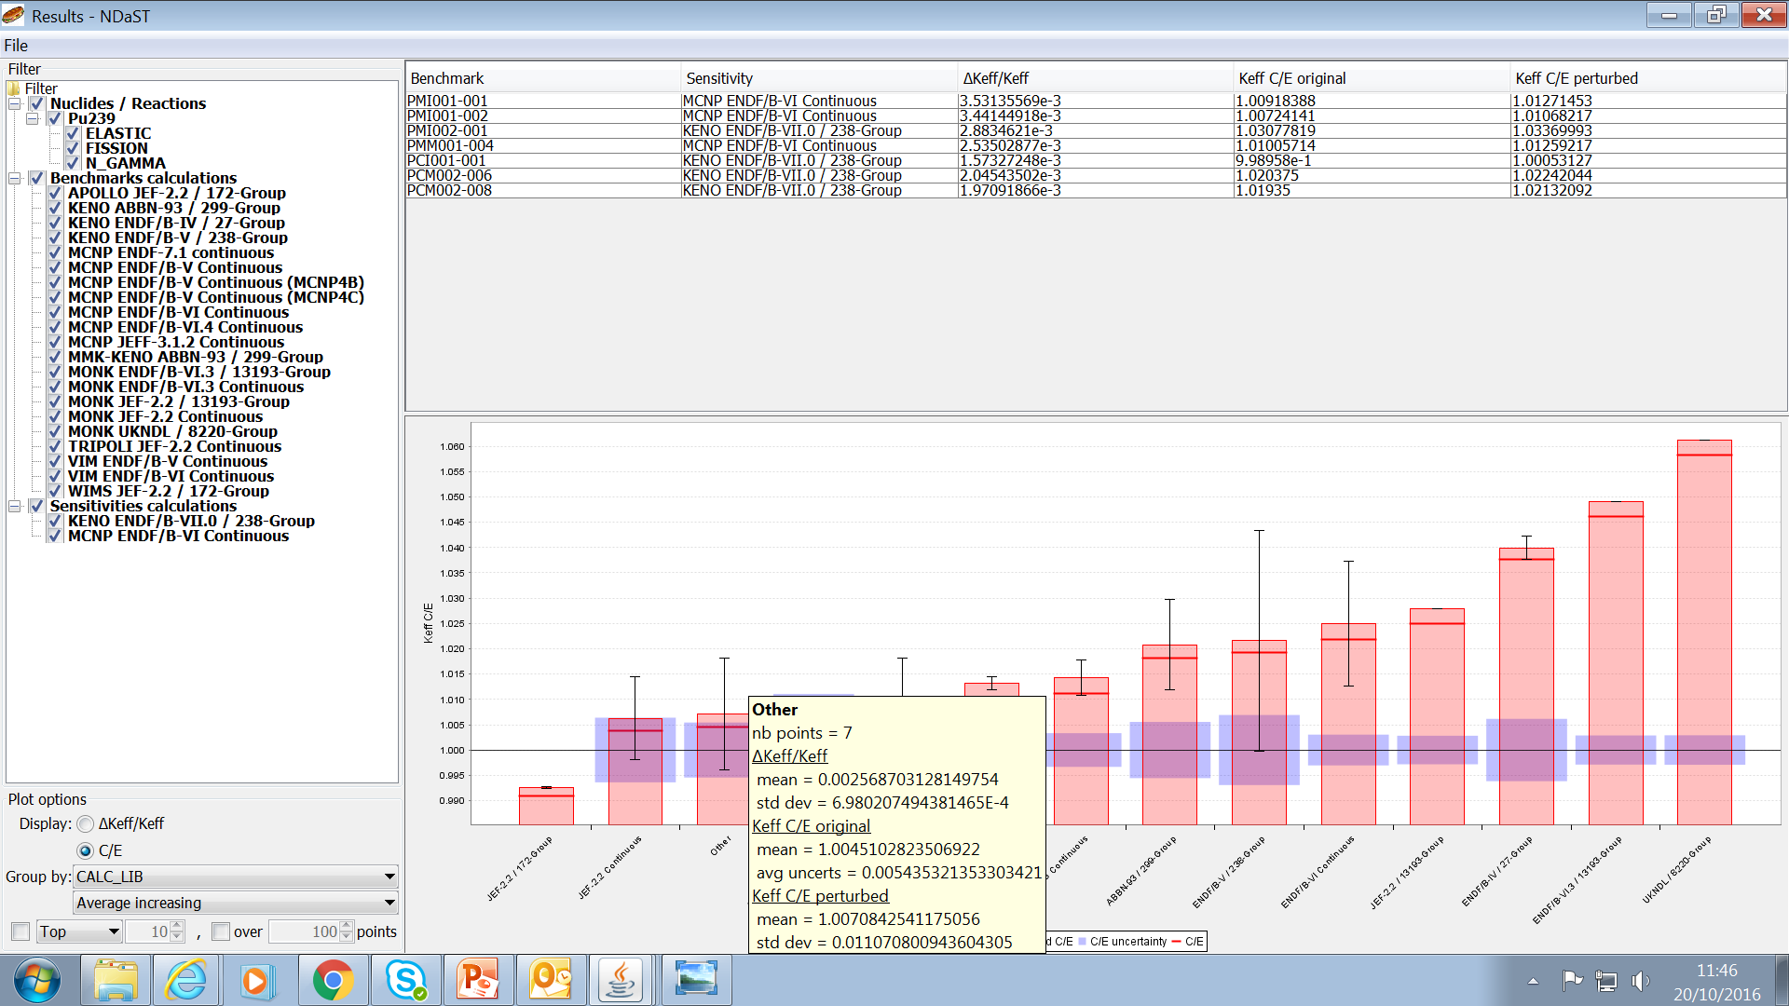
C/E Output Plot: Calculation Library + Tooltips
Use tool-tips for a quick reference quantification of each bar

Slide 39
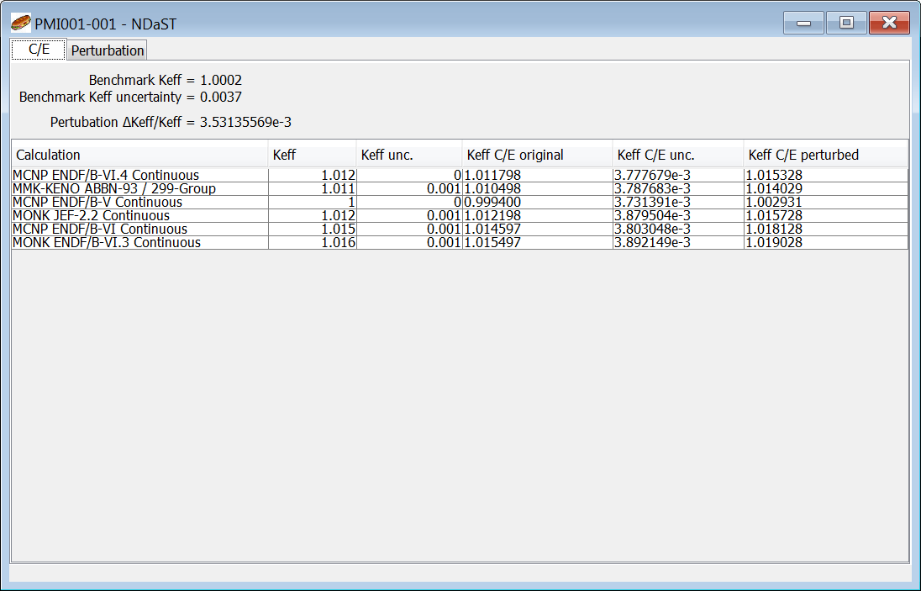
Output Table: Detail Popup (C/E)
Double click a table entry to see the detail behind the average values i.e. complete breakdowns

Slide 40
Output Table: Detail Popup (Perturbation)

Slide 41
Exercise 1 - Perturbations
Choose BMs based on some sensitivity criteria to Pu239
  Select top cases (max ~10)
Edit the cases with ‘personal’ k_{eff} calculations
Input a simple 3 group perturbation for 3 main reactions
  Elastic, capture, fission
Run the tool and get an output sorted by spectrum
  Try excluding all non ‘personal’ results
Decide if this improves each of the results
Do this again, but with a full ‘JANIS ratio’ computation
Analyse which energy region has the biggest impact

Slide 42
Exercise 1 – Example Perturbations
Benchmark | ENDF/B-VII.1 Calculation
PCI001-001 | 1.0095 ± 0.0002
PCM002-006 | 1.0150 ± 0.0002
PCM002-008 | 1.0180 ± 0.0002
PMI001-001 | 0.9970 ± 0.0002
PMI001-002 | 0.9980 ± 0.0002
PMI002-001 | 1.0050 ± 0.0002
PMM001-004 | 1.0120 ± 0.0002
Search DICE for
Pu fuel cases
sensitive to intermediate fission
>= 0.2 %dk/%dΣ
Add data from these tables
Predict effect of replacing
JENDL-4.0 / ENDF/B-VII.1
 | Pu239 elastic | Pu239 fission | Pu239 capture
1E-4 - 0.625 eV | 1.070 | 1.000 | 0.998
0.625 - 100 keV | 1.000 | 1.006 | 1.004
100 keV - 20 MeV | 1.045 | 0.997 | 1.232
Notes:
For Fast example, try selecting benchmarks with capture <-0.009

Slide 43
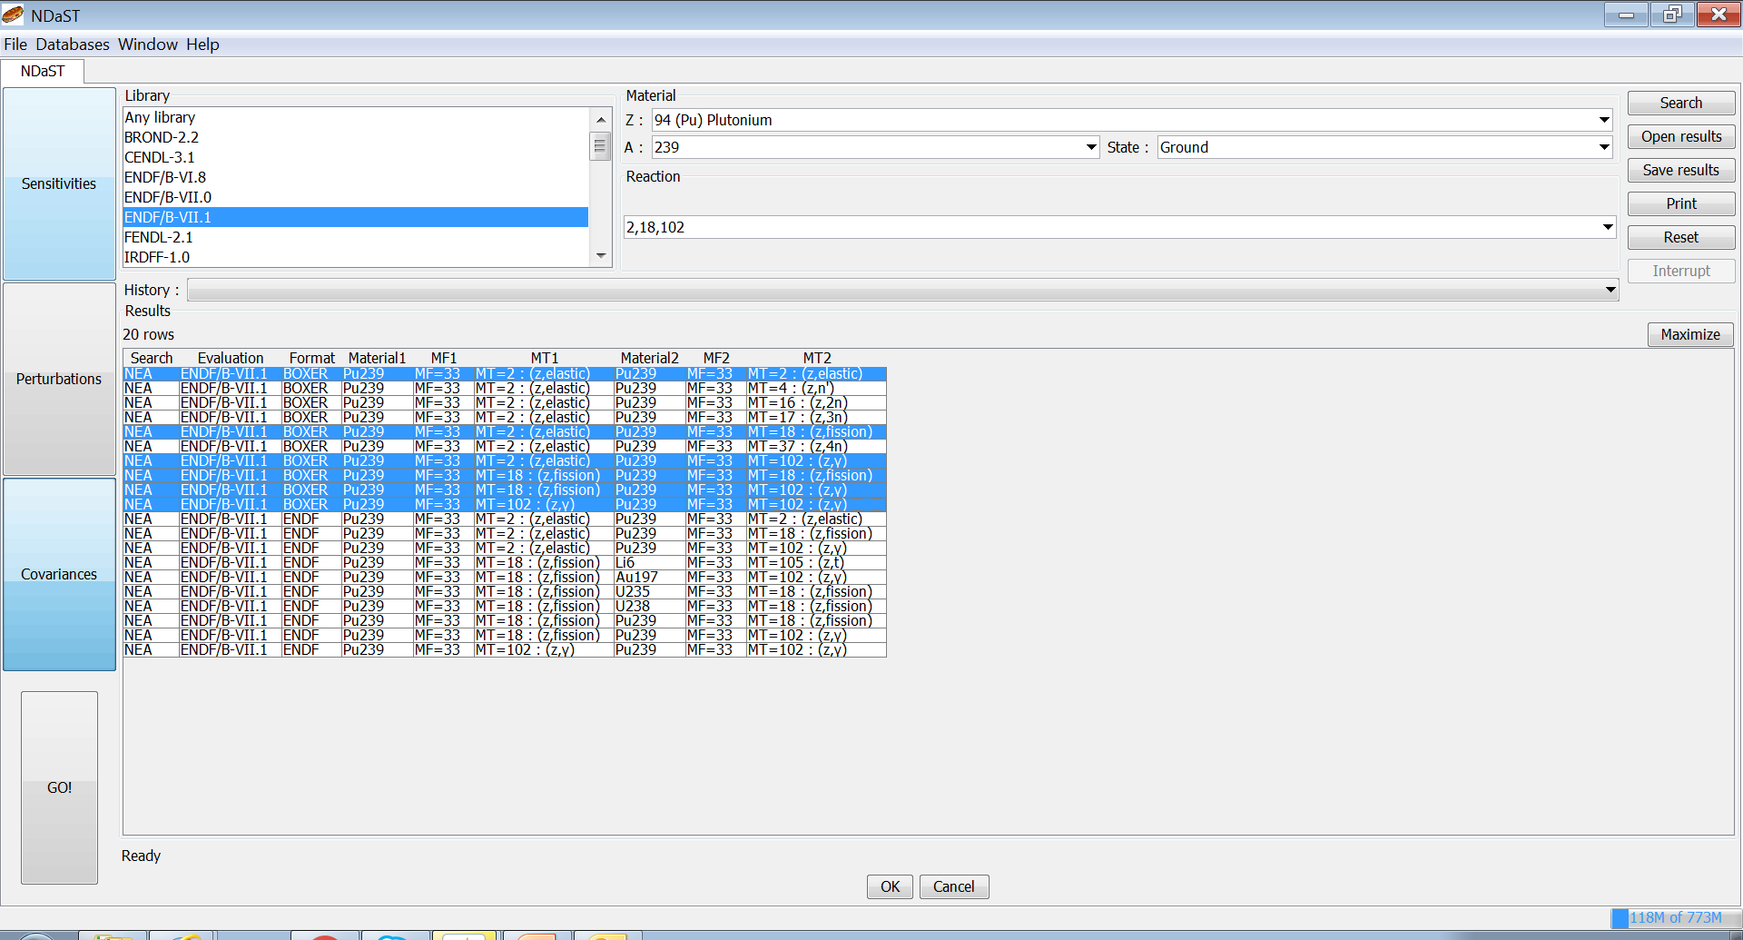
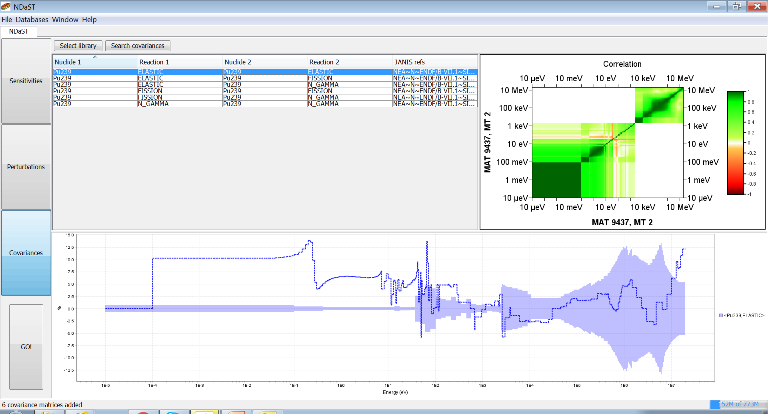
Panel 3: Select XS Covariance Data
Covariance data selected from JANIS for uncertainty propagation calculation
Many different sources of covariance in NEA base
You can also add your own to JANIS and use within NDaST (slightly advanced)
Correlation and standard deviation plots from JANIS are shown
Relative standard deviations plotted against perturbations if they exist

Slide 44
JANIS Covariance Search
Note use of commas in search
Only add BOXER format data
Use the ctrl+click row function

Slide 45
View Selected Covariance Files
Use only the ‘Search covariances’ button (for now!)

Slide 46
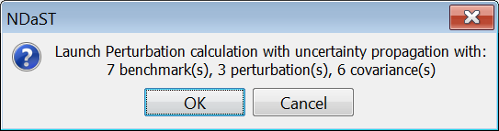
Launch Uncertainty Calculation

Slide 47
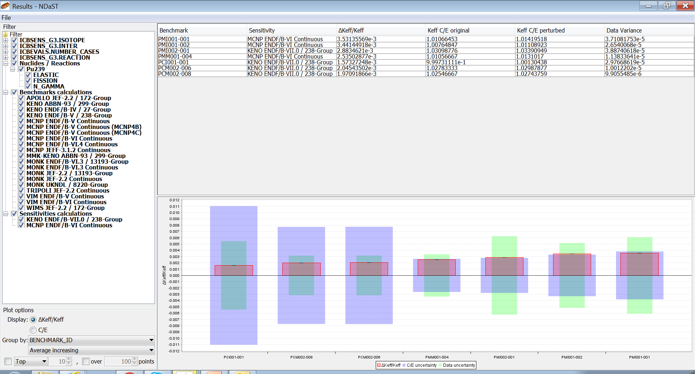
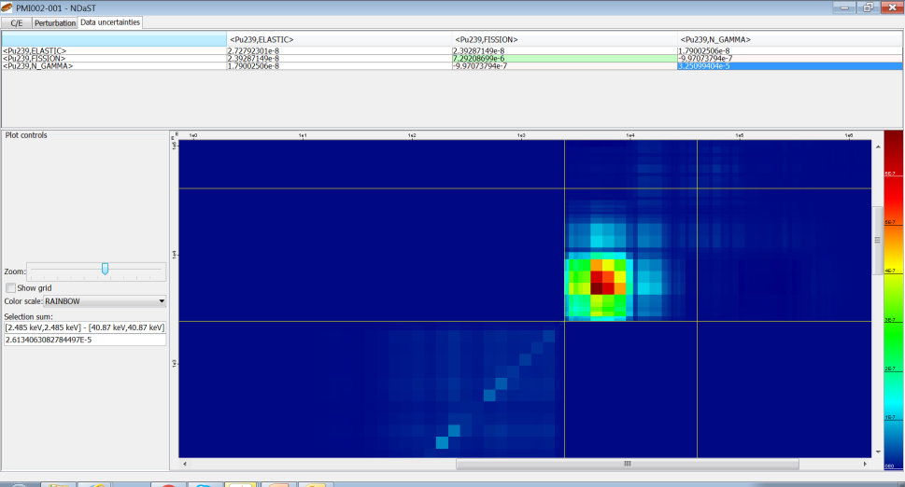
Output Window and Plots (2)
Results table of Δk_{eff}/k_{eff ,} original & perturbed C/E + XS uncertainty
Grouped plot below – toggle either Δk_{eff} or C/E + XS uncertainty bar
Detail pop-up to see complete data behind each benchmark in the table
  Nuclide-reaction breakdown of total Δk_{eff} + XS uncertainty (new tab)
  Energy breakdown of XS uncertainty as colour / heat map
  Range selection of heat map to quantify contributions + clipboarding

Slide 48
Delta k_{eff} Output and Plot
The added green bars show the grouped nuclear data uncertainty (1σ)

Slide 49
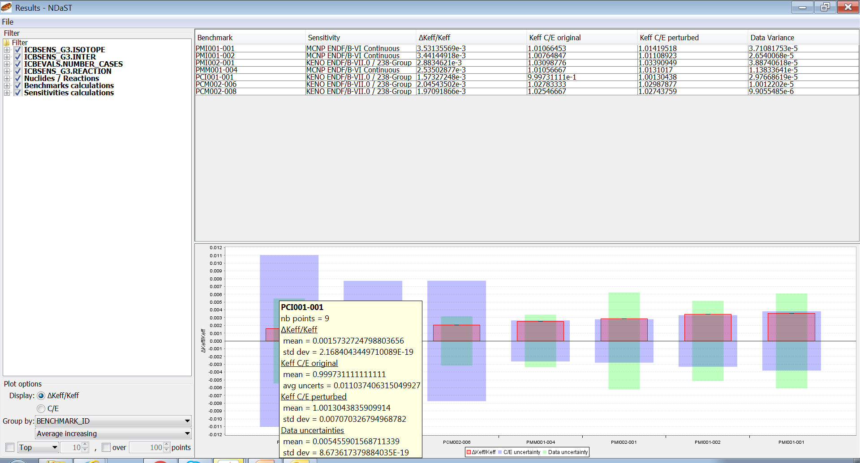
Delta k_{eff} Output: Tooltips
Again, tool-tips can give access to the values stored behind

Slide 50
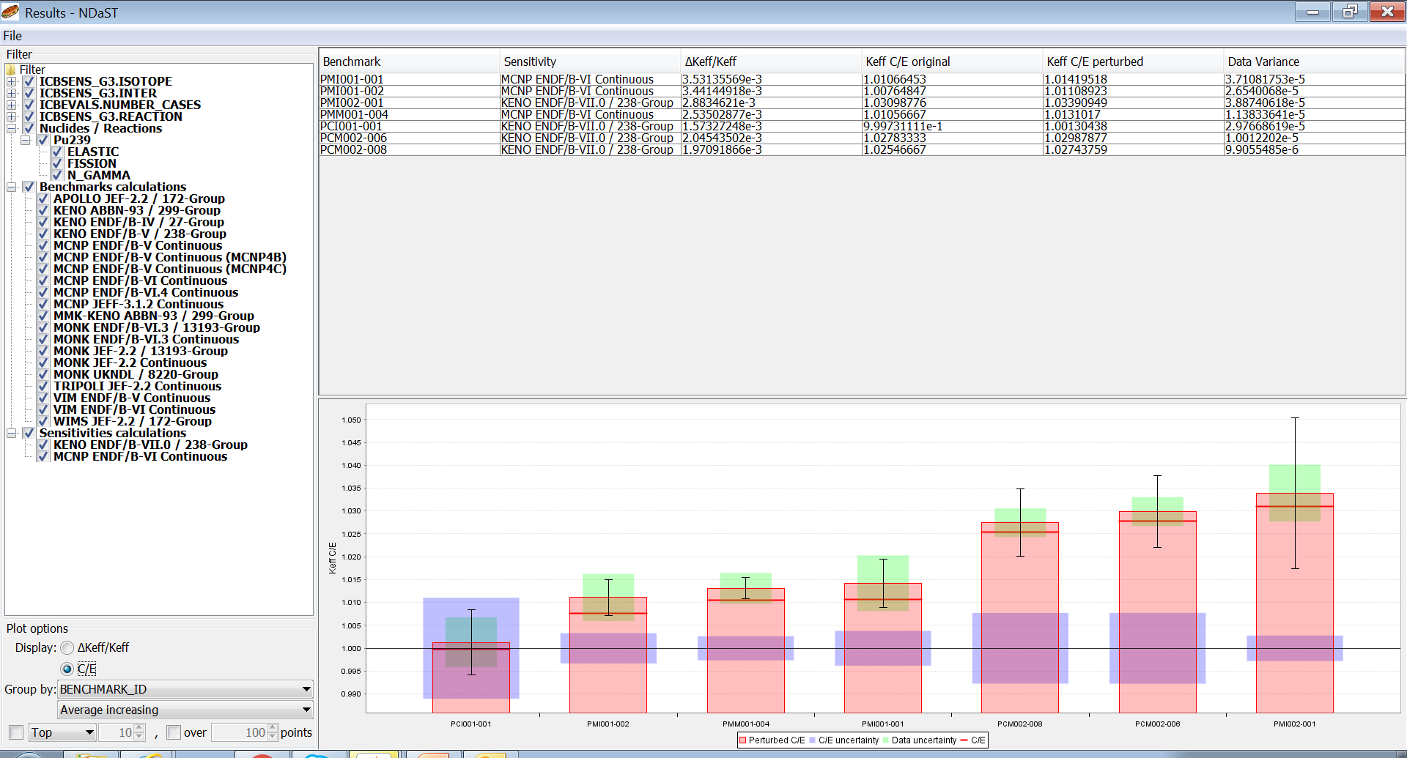
C/E Output Plot: BM ID
For the C/E plot, green bars were chosen to be centred on the red bar height as they are an uncertainty associated with the input data

Slide 51
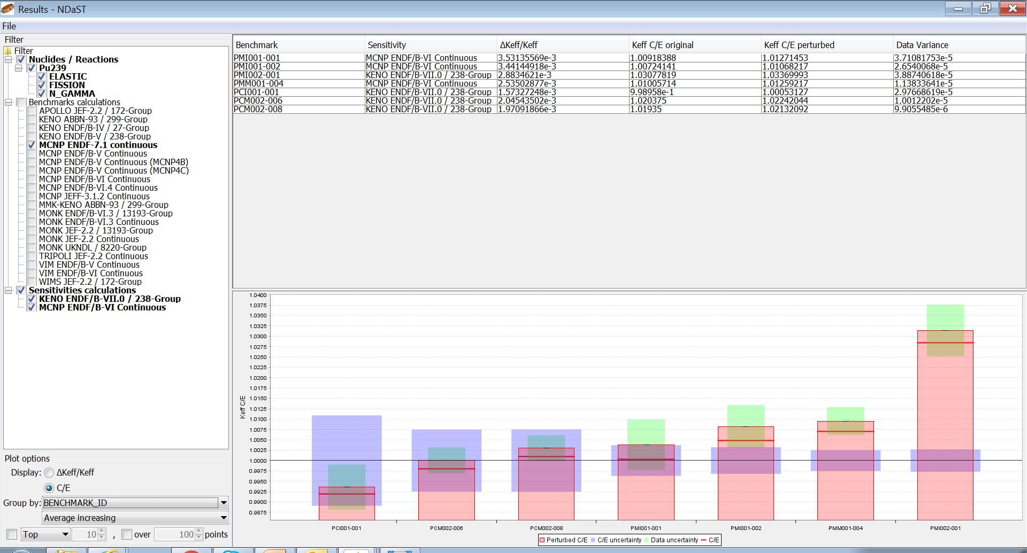
C/E Output Plot: BM ID Filtered
Filtering to a single series of calculational results allows some real validation judgement

Slide 52
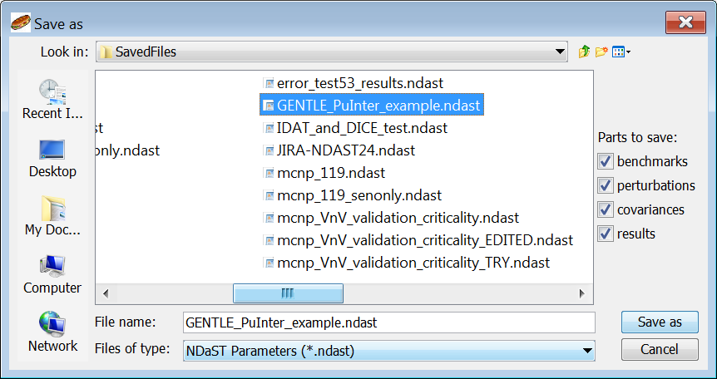
Save Output Data

Slide 53
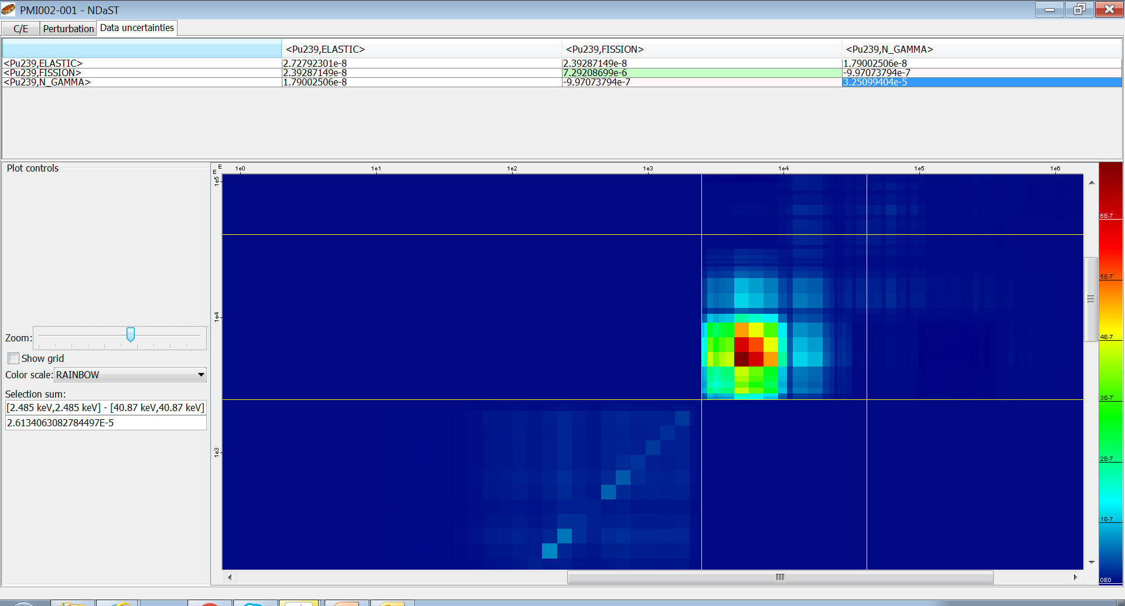
Output Table: Detail Popup (Uncertainty)

Slide 54
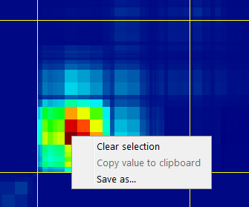

Output Table: Detail Popup (Uncertainty)

Slide 55
Future NDaST Plans
  NDaST principles: 1. Fast 2. Provides Insight 3. Integrates NEA Tools
  Applications / End results (features for users higher up the application chain)
  Phase 2:
    Continue to improve GUI features – e.g. automatically fill available nuclides
    Provide useful statistical metrics – represenativity (Ck), chi-square values, adjustment based quantities
    Total NDaST – multiple files randomly generated + statistical analysis of distribution
    Link to NDEC – automatic perturbation generation from checking cycle
  Phase 3+:
    With access to correlation coefficients, a full adjustment / GLS tool is possible.
    Application specific features e.g. parameters to trend criticality safety / burn-up credit analyses.

Slide 56
Future NDaST Plans
  NDaST principles: 1. Fast 2. Provides Insight 3. Integrates NEA Tools
  Physics / Fundamentals (features for users closer to the basic data)
  Phase 2:
    Compensating effect analysis – automatically preserve well known values e.g. total cross-section.
    Incorporation of further sensitivity and covariance data formats.
    Make available additional covariance data – allow comparison of all major modern libraries.
    Handling of angular sensitivity data and MF34 uncertainty propagation.
  Phase 3+:
    Generation / comparison of analytical models – e.g. Maxwellian & Watt PFNS representations. Analytical covariances?
    Re-fitting experimental data to make fundamental ENDF-format file perturbations.

Slide 57
Exercise (2) – Add Covariances
Find covariance data for the 3 reactions
Add these + cross-nuclide matrices (Find all 6)
Check the perturbations against the s.d. values
Re-run and look at the plot with green bar added
  Check consistency of perturbation against uncertainty
Look at the diagonal / off-diagonal breakdown
  View energy breakdown
  Use region selection and clipboarding
Try replacing with another library’s covariances and re-run
  Put the two output plots side-by-side

Slide 58
Summary
~4200 cases (~85%) have 3 group sensitivity data and full sensitivity profiles within DICE – similar also in IDAT
Additional means of identifying relevant benchmarks, to more traditional practices
An open web-based JAVA tool named NDaST is now available to take advantage of these data
Enable rapid scoping of changes to nuclear data and to propagate nuclear covariance data uncertainties

Slide 59
Summary
It also gives access to JANIS for automation of computations and use of processed nuclear covariance data
Complement to full testing calculations e.g. via the NEA Nuclear Data Evaluation Cycle (NDEC)
2016 marks the full release, following a beta testing period
Updates following this are expected on an annual basis

Slide 60
Thank you for your attention
Now you’re trained, please try out NDaST in your own time, for your own applications
We are interested in all feedback (good and bad) as we build and understand the user base
New features will be prioritised according to our estimation of user interest
Website: www.oecd-nea.org/ndast/
Email: ndast@oecd-nea.org

